Slide 1
Treating Men with Substance Use Disorders
The Male Client
Strong feelings of shame and in-adequacy may arise whenever the male client consciously or subconsciously perceives that he is not living up to socially defined norms of male behaviors, such as not asking for help and not being emotionally vulnerable.
(Shamefully cribbed from A Treatment Improvement Protocol, Addressing the Specific behavioral Health Needs of Men, Tip 56)
SAMHAS, 2013

Slide 2
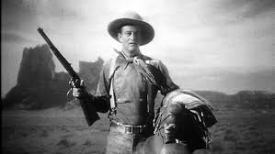
Assessing Male Clients
Assess Personal Definitions of Masculinity
Stereotypical roles that define men within a culture, called “male ideologies,” systems of beliefs, values, or ideas shared by a social group and often presumed to be natural or innately true….
(whether they are or are not)
Masculinity ideologies affect how many think and feel about themselves and influence how they behave. If not considered, may compromise the SUD treatment provided.

Slide 3
Assessing Male Clients
Also may be overlooked in assessing male clients:
Trauma
Men with SUD often have experienced multiple traumatic events during their lives and SUD also increases their risk of trauma exposure. Those who have grown up with violence, been involved in gangs may suffer from undiagnosed traumatic brain injuries (TBI).

Slide 4
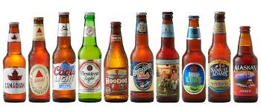
Boys Learning to become men….
Rituals of Male Passage
Men demonstrate their mas-culinity thru sports competition, speeding in cars, sexual conquests….
In our society, manhood rituals lubricated with alcohol, eventually alcohol becomes an end in itself.
i.e. Binge drinking among youth has become ritualized behavior.
Alcohol/drugs mark transitions in adulthood, such as turning 21, marriage, becoming a parent…
in lieu of communicating with and learning from older men or women.
Why AA creates alternative (non-alcohol) methods of marking milestones…

Slide 5
Characteristics of Masculinity
Emotional Restraint
Suppress feelings deemed to be feminine when confronted with loss, grief, etc., resorts to drugs, not peers.
Even mild social male drinkers report significantly more alcohol cravings as the result of negative emotional status than women.
(Chaplin et al 2008)

Slide 6
Characteristics of Masculinity
Alexithymia (inability to experience and/or communicate feelings) is not unusual in SUD treatment populations. In a study of alcohol treatment population, 30% so diagnosed.
(Evren et al 2008)
Emotional Restraint
Men have trouble identifying & expressing feelings, increasing anxiety, may express feeling nonverbally (violence/withdrawl) or suppress feelings with drugs.
Why sadness or anger may be predictive of violence.
More pronounced among men with SUD.

Slide 7
Characteristics of Masculinity
Competition
Must get ahead, zero sum game.
Inability to win makes males perceive themselves as failures, leads to insecurity,
feelings suppressed with drugs.
Ironically, reverse is also true, celebrate achievement with drugs!
Male college athletes drink more than non-athletes
(Martens et al 2006)
AA Slogan
“Live and Let Live.”
(Life is not zero sum game!)

Slide 8
Characteristics of Masculinity
Aggression
Males socialized to be aggressive, fearless, invulnerable, take risks, including drink, drug use.
Alcohol/ drugs stimulants make men more aggressive than women, increasing male risk behavior.
Men who are less risk adverse die younger and at greater rate than women, less likely to engage in preventative treatment.
Also increased stress increases medical conditions, i.e. men with more “feminine” traits less likely to die of heart disease.
(Hunt et al 2007)

Slide 9
Characteristics of Masculinity
Sexual Accomplishment
Fear of femininity causes men to become counter dependent and emotionally vulnerable to no one, view sex as an achievement or a goal, rather than element of a relationship.
Drinking/drugs may be linked to desire to fulfill male role expectation of power, dominance, and control over women.
Homophobia
Confusing sexual orientation with gender identity, homosexuality is threatening, undermines gender stereotype behavior.

Slide 10
Characteristics of Masculinity
Independence & Self Sufficiency
Help seeking implies dependence, vulnerability, submission to health care provider.
Self reliance can lead to increased psychological distress but decreased willingness to seek help for psychological problems.
Men less likely to see doctor, underutilize healthcare services.
Though men drink more, less likely to seek help for abuse, less likely to participate in medication assisted treatment for SUD.

Slide 11

Please Note:
Gender roles also have value
(Viva la difference!)
Concern with
“Dark side of masculinity…”
Rigid, sexist gender roles that result in personal restrictions and devaluation of self or others, linked to shame, violence, depression, and anxiety and inhibit recovery.
(O’Neil et al 1986)

Slide 12
Drugs and Gender
Neural responses differ by gender, men more likely to say that cocaine increases sex drive, more so than women report.
Also applies to methamphetamines and opioid use disorders. Men show greater loss of mental faculties relating to executive function and memory than women, persisting even after abstinence.
(Ersche et al 2006)
Executive Functions:
Plan, organize and complete tasks, including impulse control, emotional control flexible thinking, working memory, self-monitoring, planning & prioritizing, task initiation, & organization
Suggests usefulness of gender-specific treatment…

Slide 13

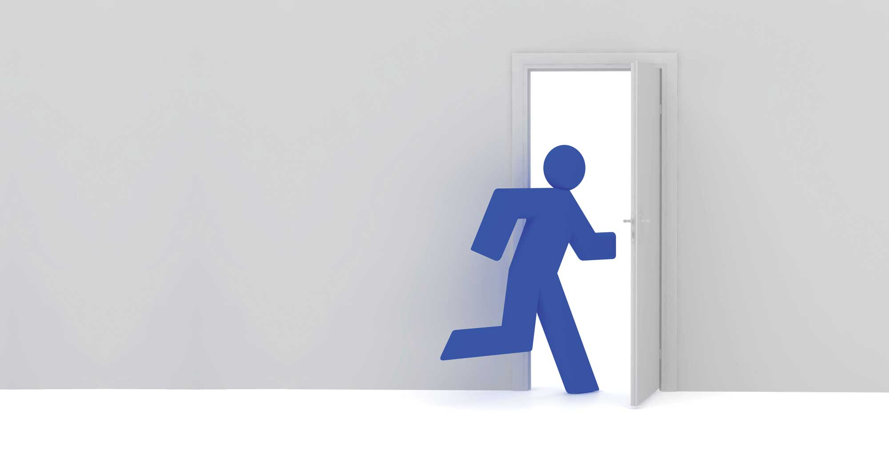
SUD Treatment and Gender
Regardless of age/ culture, men less likely to seek treatment than women, more likely to leave treatment early.
So motivational interviewing, treatment engagement skills paramount for treaters of men.

Slide 14
Assessing Personal Definition of Masculinity
Clinician should assess client’s personal definition of Masculinity to explore both positive and negative functions it may play in treatment and recovery.
Clinician and client together figure out what changes may be necessary for more effective treatment plan.
i.e. Success at all costs?
Interferes with personal life?
Refuse to accept help?
Need for independence?

Slide 15
AA/NA Steps and Slogans
AA Wisdom
→Live and Let Live
→ Let Go, Let God
→Admitting to be powerless, lives unmanageable
→ Need power greater than ourselves to restore us to sanity
→ Take cotton from our ears and put in our mouths
→Serenity is not absence of conflict but ability to cope with it
→Under every dress is a slip
Dark Side of Masculinity Addressed
→ Life is not zero sum game
→ Need to ask for help
→ Need to depend on others
→ Develop emotional range beyond aggression
→ Have to relearn how to relate to women

Slide 16
Assessment Instruments
The Male Role Norms Scale (Thomson & Peck, 1986)
Gender Role Conflict Scale (O’Neil et al 1995)
Masculine Gender Role Stress Scale (Eisler 1995)
Brannon Masculinity Scale (Brannon & Juni, 1984)
Male Role Norms Inventory (Levant et al 1992)
Conformity to Masculine Norms Inventory (Mahalik et al 2003)
Note: These used in research, no reliable normative data for any, but can be used to improve understanding of issues relating to masculine roles/norms.

Slide 17
Conformity to Masculine Norms Inventory (CMNI)
Winning
Emotional Control
Risk-Taking
Violence
Power Over Women
Dominance
Playboy
Self-Reliance
Primacy of Work
Disdain for Homosexuals
Pursuit of Status
There was strong support across all studies for the validity of CMNI total score as it related to all the constructs of interest...All of the CMNI subscales were significantly and positively related to other masculinity-related measures, with several subscales being related significantly and positively to psycho- logical distress, social dominance, aggression, and the desire to be more muscular, and significantly and negatively to attitudes toward psycho- logical help seeking and social desirability…
Mahalik et al 2003

Slide 18
Assessment
Family history
History of childhood abuse and neglect
Current physical or sexual violence in family (SUD/ Domestic Violence Association!)
Male sexuality (genital combat vs. relationships)
Shame
Assessing Shame
Test of Self-Conscious Affect-3 (Tangney & Dearing, 2002)
Differential Emotions Scale
Experimental Shame Scale
State Shame and Guilt Scale
Internalized Shame Scale (Cook 2000)**
**Reliability and validity of the scale documented using men who w/SUDs. Used to associate internalized shame with male gender role conflict.

Slide 19
Assessing Shame
Internalized Shame Scale (ISS) measures shame as negative emotion, magnified and internalized as feelings of inferiority, worthlessness, inadequacy, and alienation.
(Cook DR. Internalized Shame Scale: Professional manual. Menomonie,WI: Channel Press; 1994; Cook DR. Empirical studies of shame and guilt: The Internalized Shame Scale. In: Nathanson DL, editor. Affect, scripts and psychotherapy. New York: Norton; 1996.)
I feel like I am never quite good enough
I feel somehow left out
I feel I have much to be proud of
I see myself as striving for perfection only to continually fall short.
I replay painful events over and over in my mind until I am overwhelmed
I take a positive attitude toward myself
30 measures in all…

Slide 20
Engaging Men in SUD Treatment
Since men may have trouble identifying, discussing emotions, don’t push clients so as not to overwhelm them.
i.e. Talking while walking may decreased intensity of direct eye contact and allow clients to dissipate excess energy.
Emphasize options and free choice, even when limited, to support men’s need for a sense of independence and autonomy
Don’t confront right/wrong, which just increases resistance, use more subtle, less confrontational manner
Reframe coming to RSAT treatment as a success, sign of strength and courage

Slide 21
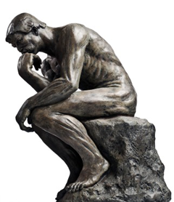
Engaging Men in SUD Treatment
i.e. node-link maps (consequences of life choices) (Czuchry & Dansereau 2003 NIDA 1996)
genograms (DeMaria et al 1999; McGoldrick et al 2008)
timelines (Suddaby & Landau, 1998)
Some men may find it easier to discuss problems using visual references, timelines (Halpern 1997)

Slide 22
Node-Link Map

Slide 23
Other consequences…..in their own words
Opioid use disorder
Risk of HIV/AIDS
Seeing friends die
No pension plan for crime
Parents having to lie about you
(ie has apartment on South Shore)
Growing to old for this s….
Fear of return to prison again
Nothing to show for it…
Recovery
Experience Joy
Ability to smell the roses
Enjoying sex
Feel better
Legit income for bubble bath
Better company
Sanity
Custody of child

Slide 24
Addressing Gender Bias and Stereotyping when working with male clients
Male Counselors:
Explore your own gender biases, refrain from stereotyping men
Don’t assume client’s lived experience based on gender
Be supportive and help male clients touch upon emotional content
Take client preference for counselor gender into consideration when possible
Raise issue of gender in assessment and as therapeutic issue
Explore your own countertransference issues in client supervision
Female Counselors:
Ditto
Ditto
Don’t be afraid to challenge male client’s psychological defenses and behavior in a nonjudgmental, non-shaming way
Ditto
Ditto
Ditto

Slide 25
Countertransference
Countertransference reactions are the attributes counselors assign (from their histories) to their clients
For female counselors: If ever experienced being belittled or ignored by men in authority, may experience unresolved anger. May subconsciously fear male client will ignore, judge, or belittle her, take over therapy from her or reject her help.
Challenge: walk line between being supportive, accepting and willing to (gently)challenge male client’s psychological defenses—denial & minimization that drugs interfering with his life & relationships.

Slide 26
Countertransference
For male counselors:
If ever felt he didn’t measure up, i.e. disappointed family for low wages, may feel belittled by client.
Challenge: Realize client’s belittling behavior strategy of competitiveness as a way to hide client’s shame for addiction/need for treatment

Slide 27
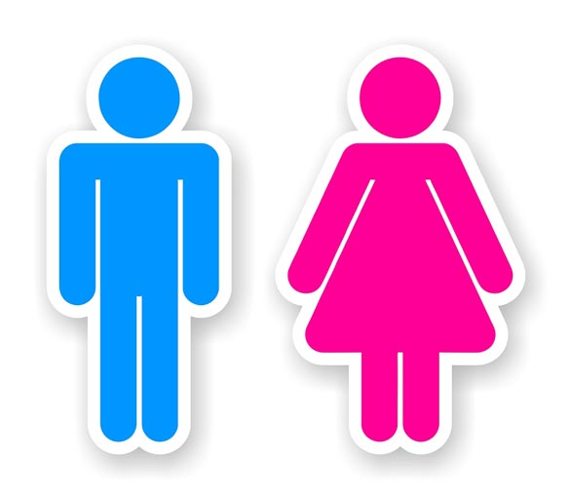
Client Gender Preference for Counselors
Studies find males prefer female counselors but when asked to list attributes, not gender specific.

Slide 28
Challenges Female Counselors Face
Client may see male counselor as more real, powerful, important; female counselor lacks same authority, power, credibility
Note: Inmate observe how male COs treat female counselors, may reinforce this (ie refer to female counselors as “girls”)
Male clients don’t “hear” women, not used to communicating w/women
Antagonistic and biased against women in authority
Betty Ford Center and Hazelden Clinic allow only male counselors to work with all male treatment groups.
Men tend to address concrete tasks more readily with male counselors, which may work more effectively in a treatment setting that uses task-oriented brief therapy, solution-focused techniques, and motivational interviewing (Lyme et al 2008).

Slide 29
Transference Issues for female counselors
Transference: Attributes clients assign to their counselors.
Sexualized Transference
In therapy, counselor invites male client to engage in a kind of intimacy that may not be present in client’s other relationships. Client may feel emotional and/or sexual attraction for the counselor. (Exacerbated in prison/jail where may be only female around.)
Substance abuse counselors may have little training in how to address client transference feelings, particularly sexual feelings. May take client adoration as the real thing.
RSAT staff must be firm about boundaries.
Key:
Sexualized transference is common part of counseling relationship, should be viewed as potentially useful therapeutic opportunity to help male client lessen impact of shame in his life while modeling healthful ways of expressing and managing intense feelings.
i.e. acknowledge client’s attraction in nonjudgmental way, establish professional boundaries without shaming client, use disclosure to reinforce the idea that feelings and impulses do not have to be acted out in negative ways, but can be expressed in ways that support hopes and values.

Slide 30
Transference issues for male counselors
When power elements surface, the male therapist goes into competitive mode, once he give that up, he begins to feel closer and more vulnerable to the client, which raises homophobic issues and necessitates a pulling back…
Scher 2005 (p.317)
Key is for male counselor to be supportive, model vulnerability, and develop intimacy required to establish strong therapeutic alliance without pulling away from the male client due to internalized homophobia or without becoming competitive and dictating treatment goals and plans from the position of the expert?

Slide 31
Addressing Male Clients w/ Deficits in Emotional Expression
May respond to psychoeducational efforts to reduce problems related to feeling and expressing emotions for men (Levant et al 2009)
Apply feeling words to their internal/physical experience
(“What I hear you saying…”)
Help client ID emotions that are most comfortable for him (ie being scared) and deal with these first
Intervene if others in group confront him on his inability to express certain emotions
Help client set goals for participation in group, particularly re emotions
Develop self grounding techniques for use when he becomes anxious when others express powerful emotions
Provide homework assignments to help him express his emotions in structured context (ie expressive writing assignments found to decrease emotional distress for men w/ restrictive emotionality (Wong et al 2006))

Slide 32
Anger Management
Common problem for men with SUDs and it can be made worse by stress of early recovery. Anger may be one of the few emotions men feel comfortable expressing, use it to cover up other emotions (i.e. fear, grief, sadness) that they can’t express.
Trait anger associated with SUDs as well as physical aggression. (Awalt et al 1999;Giancoloa 2002)
Men with anger problems more likely to relapse (Kirby et al 1995; McKay et al 1995)
Cognitive behavioral interventions work with men with SUDs (ie timeouts, cognitive restructuring, conflict resolution, relaxation training) (Reilly & Shopshire 2000)
Motivational enhancement therapy or MI may be more effective than CB in reducing substance use for men with high level of anger. (Stout et al 2003)
But the latter may be that clients do better when counselors less directive as MET counselors are. (Karno & Longabaugh 2004)

Slide 33

SAMHSA Anger Management Curriculum
SAMHSA Store
http://store.smahs.gov
Or download
http://kap.samhsa.gov/products/manuals/index.htm

Slide 34
“Male” Issue Challenges
Violence
Violent crime strongly linked to alcohol and drug use. Many perps have also been victims
Nurturing
SUD clients need to learn nurturing skills in their roles as husbands and fathers
Counselors can teach and model affirming, caring, nurturing, forgiving, and patience
Emotional vulnerability is critical and important to recovery.
Encourage non-stereotypical activities that promote cooperation, etc. Encourage service activities
Shame
SUD clients in treatment rate high levels of shame, kept them from entering treatment…
Shame barrier to recovery, prevents inward looking, self assessment, lead to “white knuckle abstinence” with high likelihood of relapse.

Slide 35
Treatment
Enhancing Motivation – client centered, reflective approaches vs. authoritarian, adversarial, confrontational style
Motivational Interviewing- Focus on client strengths not weaknesses, strategies for change
www.motivationalinterviewing.org
Coerced in treatment- clients do as well or better
Relapse Prevention -Men have higher relapse rates for drugs than women
Relapse: interpersonal (social pressure) and intrapersonal (negative emotions like depression)
Men more likely to attribute relapse to interpersonal factors (but may be because men don’t ID intrapersonal factors)

