Slide 1
Supporting Better RSAT Engagement:
Recovering Clients Affected by Trauma & Violence
5th Annual RSAT Workshop
Providence, Rhode Island
July 25th -27th 2016
Niki Miller, MS, CPS Lisa Talbot Lundrigan
Senior Research Associate Vice President
Advocates for Human Potential, Inc. AdCare Criminal Justice Services

Slide 2
Goals of Trauma-informed addiction treatment
High-risk behaviors, recovery challenges & barriers
to treatment engagement - related to past trauma…
Not to excuse …
Not even to explain…
Managing these types of responses helps RSAT clients
overcome roadblocks to recovery:
♦Prevent or reduce health costs & consequences
♦Reduce stress among staff & inmates, alike
♦Improve engagement in effective SUD treatment
Miller (2013)

Slide 3
Results of Implementation (Miller & Leis, 2013)
Observations from justice professionals:
“When program staff knows there’s a trauma history, inmates are relieved not to have to keep repeating their story”
“Less resistance from drug court clients; view the court as a safe place”
“Noticeable improvements among women in treatment programs”
“They have started letting staff know they need a respite, before behavior accelerates”
Drug Courts, Veteran’s Courts, Local Jails, Prison-based Substance Abuse Treatment, Female Offender Programs

Slide 4
Learning Objectives
Miller, 2013
Trust your instincts, based on what you know & may learn
View self-care & supervision as essential
Try new techniques & tools
Share information & check out resources

Slide 5
Trauma-Informed vs Trauma Specific
Applied to RSAT SUD Treatment Settings
Informed:
Staff understand trauma’s impact on addiction recovery & rehabilitation
Modifications enhance stability, deal with triggers & re-traumatization
Responsivity: eliminate roadblocks erected by trauma
Specific:
Clinical/program staff trained in integrated recovery approaches
Interventions aimed 1st phase trauma recovery goals: establishing safety
Empowering clients to self-manage ongoing effects
(Miller, 2008)

Slide 6
Applying trauma-informed approaches in RSAT Programs
Universal measures
Screening and referral
Integrated treatments
Applied without prior screening to risk groups
Harmless to those without trauma
What can or cannot become part of SOPs?
Screens for current functioning & safety
How does screening benefit the inmate?
Who should screen When? How?
Combined recovery -trauma/addiction
CBT can also help depression & criminal thinking
What is the impact on outcomes?
Notes:
Trainer notes:
There are several ways to implement trauma informed approaches. This training is aimed at universal measures, but what is right for your program may encompass elements of one or more of the other approaches.
Each approach has advantages and different requirements to consider.

Slide 7
Principles of trauma-informed addiction treatment
Assumption of trauma history; even if not disclosed or remember
A safe, structured & predictable treatment & recovery setting
Know the function of problematic responses – find viable alternatives
Emphasizes accountability & consistency instead of authority
Models respectful connections with others – informs & offers hope
(Miller, 2011)
Notes:
Trainer’s notes:
Trauma-informed care is founded on a set of principles that guide the culture of programs. No matter how triggering an environment may be, therapeutic relationships with staff that understand and embody these principles can result in a more effective experience for clients with trauma histories. These principles are compatible with evidence-based substance use disorder treatment and motivational approaches. They are easily integrated into treatment programs.
We have learned about how trauma affects drug court clients, let’s take a few minutes when we return to explore the ways it can affect staff.

Slide 8
Potential Impacts of Early Trauma
Brain development - lasting changes in cognitive functioning
Physical - increases risk of disease, disability & early death
Adoption of health risk behaviors – all addictions, HIV, etc.
Powerful predictor of adulthood victimization
Responses & belief systems aggravate criminogenic risks
Social, emotional, & interpersonal consequences
Miller, 2015

Slide 9
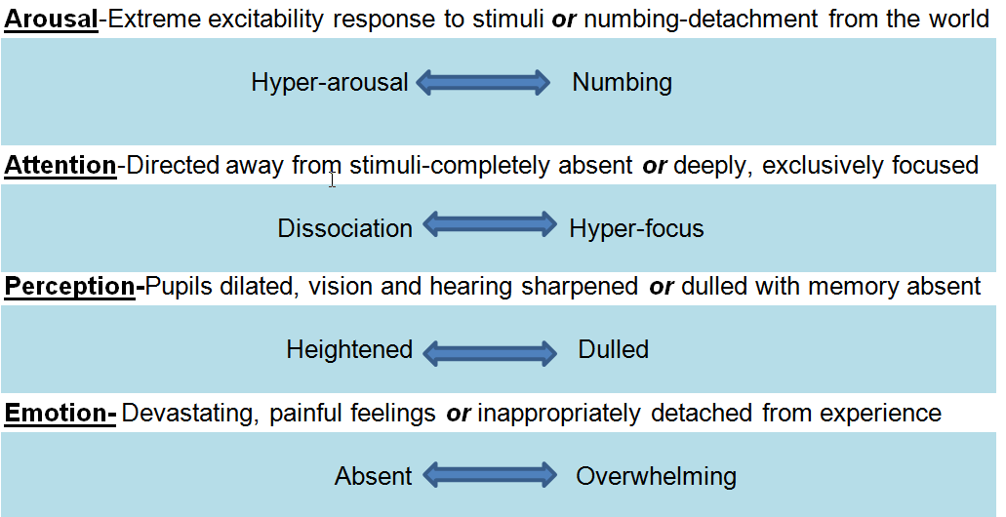
Changes in Key Cognitive and Affective Functions
(Miller, 2010)

Slide 10
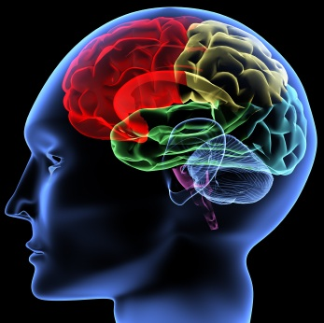
Brain’s Response to Prolonged/Severe Exposures
Primitive fight or flight responses alter cognition & emotion (physiological /psychological)
Blood flows out of the brain & into the limbs; respiration & heart rate increase, pupils dilate, hearing is sharpened etc.
Ongoing effects can be more devastating than original trauma
Staff helps to manage in treatment settings
Clients learn to self-manage in long-term recovery
Miller, 2011
Notes:
Physiological changes are activated

Slide 11
Trauma and Criminogenic Risks
Criminal Thinking/Values
“Every summer my mom made me go to church camp. One of the brothers used to come into our bunks at night and do things to us. I didn’t know he was doing it to other boys, so I kept it a secret. I thought it was just something about me that made him do it.
I decided there was no reason to play by the rules since nobody else did. The summer I turned 14, I broke into the camp office, took cash and whatever else I could find and ran. I don’t think I ever stopped.”
Miller, 2011

Slide 12
Trauma, addiction & criminal thinking/associations
Substances used to numb emotional & physical response to triggers; can predispose to thrill-seeking/risk taking
Drug using social networks: similar distrust of authority & institutions; similar beliefs about retribution & justice
Strong predictors of relapse related to trauma:
Negative emotional states & distress
Positive perception of relief substances offer
Miller, 2011
Notes:
Trainer notes:
Trauma can contribute to criminal thinking, anti-social attitudes and anti-social associations. Some examples include:
Distrust of authority and institutions
Extreme beliefs about justice and retribution
Being drawn to companions that feel the same way
Appointing oneself as a vigilante, or as an avenger and protector.

Slide 13
Implementation Basics
For correctional settings
Preliminary goals: do no harm - increase safety
Offer staff supervision, training and support
Teach basics: stabilizing skills; dealing with triggers
Integrate appropriate evidence-based treatments
Miller, 2008

Slide 14
Trauma Stabilization
Trauma stabilization tools
Grounding
Self-soothing
Self-care
Strength-based
Miller, 2013
Notes:
Trainer notes: Trauma stabilization helps establish safety and teaches coping skills to help clients manage responses that interfere with treatment engagement and learning. Once the skills have been mastered, recovery information is better absorbed. There are a number of tools that are useful to clients and easily taught by staff.
Grounding - directs attention to the here-and-now and uses the senses as an anchor to the present
Self-soothing - teaches substance-free means of calming and coping to fall back on, especially when triggered or distressed
Strength-based approaches build self-efficacy, by pointing out successful efforts to regain control, maintain abstinence and use new coping skills; reinforcing the client’s ability to change thinking, behavior and to assert control. Many clients need help identifying their strengths. Pointing out strengths, successes and survival skills, and ways they can be used in recovery is our role
Self-care - learning to self-monitor emotional states, to evaluate choices and actions, actively pursue wellness, reduce stress and attend to physical health needs.
Call attention to hand outs :
Calming Strategies
The process that staff employ to plan personal self-care activities parallels safety planning processes and techniques they can introduce to clients.
Self-soothing strategies and “advanced directives” that draw on the recovering person as the best resource for information on what approach staff should take with them when they are having a difficult time.
Let’s look at how trauma stabilization contributes to behavioral change

Slide 15
Identifying the link between triggers & urges to use
Examples available…
Advanced directives & planning for high-risk situations
What reminders are difficult to deal with?
What helps you calm down when you feel triggered?
What can staff can do to help when you’re triggered?
If urges to use are strong, is it in response to a reminder?
When reminders are strong, is the response an urge to use?
Notes:
Having a plan in advance to reduce reactions to reminders or “triggers” puts the survivor in charge even when he or she is emotionally upset. Encourage clients to identify triggers and develop coping skills to deal with them. This is the same type of skill that clients develop to plan for high-risk using or drinking situations. Looking at how these two issue intersect is often an “ah ha!” moment for clients in SUD treatment.

Slide 16
Self-Care: teach it, model it, live it!
ESCAPE! REST! FUN!
Safeguard against the toll workplace exposure can take
Flexible job duties: breaks or rotation
Time for clinical supervision & peer networks
De-stress with co-workers and others outside the field
Meaning makers make it!
An excellent free online course on minimizing the effects
of workplace exposure to trauma from the Headington Institute :http://www.headington-institute.org

Slide 17
PEACE: An approach to unavoidable triggers
Predict & prepare: What difficult situations will come up?
Enlist: What has worked for you before?
Acknowledge: This may not be easy for you…
Choice & control: How do you want to deal with this?
Explain: This can not be avoided because…
Miller, 2008
Notes:
Training notes:
In custody settings there are environmental triggers that are unavoidable. Some triggers cannot be eliminated — but they can be defused. See Handout

Slide 18
Trauma specific treatment approaches
Past
Deal with the memory
Present
Deal with the effects
Miller, 2013
Notes:
Trainer notes: This slide can be skipped if time is running short.
Clients who are healing from the effects of trauma may try a range of approaches at different points in ongoing recovery, but for clients with SUD’s, there is usually an immediate need to learn substance-free coping skills and increase safety. The focus on establishing safety gives clients with trauma a foundation to build upon.
Past- focused therapeutic approaches focus on the memory of the event, and deal with processing the memory so clients become desensitized to triggers. They are very effective, provided the treatment is well-tolerated. They are not usually used in custody settings. This is something RSAT clients with PTSD should be made aware of. They may be available in the community, especially for vets
Present-focused approaches are concerned with current symptoms and current functioning. Substance use treatment and RSAT programs favor structured, present-day approaches that focus on gaining control of trauma responses, and reducing the effects of trauma on current behavior and thinking.
Medications have also been effective for some people who have PTSD.

Slide 19
Judith Herman’s Stages of Recovery
Stages of Trauma Recovery
1. Establishing Safety
2. Remembrance & Mourning
3. Reconnection
Stage 1 Goals: Establishing Safety means….
•The survivor no longer feels completely vulnerable
•Has some confidence in the ability to protect her/himself
•Knows how to control his or her most disturbing reactions
•Knows whom to rely on for support
Notes:
Trainer notes:
Judith Herman (1992) identified three stages of trauma recovery. These stages involve specific tasks. Each person’s path is unique and some tasks are easier than others.
RSAT clients in substance use disorder treatment services can master Stage One trauma recovery tasks, which are quite compatible with addiction recovery.
Some of tasks involved are:
Gaining authority over the memory
Self-regulation/ affect regulation
Identifying and eliminating triggers and
Grieving
There are also some things that indicate safety is established. It would be wonderful if every trauma survivor achieved them prior to graduating drug court, but that may not be possible in all cases. However, it is a great yardstick for ensuring clients are moving in the right direction, or getting the help they need, in terms of trauma-specific services and supports, or if they are struggling with tasks involved in establishing safety.

Slide 20
Integrated Approaches: Examples of Manualized Treatments
Seeking Safety
Trauma Recovery & Empowerment Model (G–TREM; M-TREM)
Trauma, Addiction, Mental Health, and Recovery (TAMAR)
Addiction & Trauma Recovery Integration Model (ATRIUM)
Helping Men Recover (Covington)
From 60% to 80% of individuals with trauma-related disorders report improvement after receiving treatment!
Notes:
More information about each of these interventions is available in the TIC manual available on the RSAT website

Slide 21
Healing, Recovery & Desistance
Healing does not occur in institutions, but rather in the context of communities, relationships & families.
Miller, 2012

Slide 22
Niki Miller
nmiller@ahpnet.com
Lisa Talbot Lundgren
ltalbotlundrigan@gmail.com
Thank you for all you do and for the privilege of allowing us to speak with you. Do not hesitate to contact us if we can be of assistance.

