Slide 1
The Affordable Care Act and RSAT Programs: Rights Resources and Responsibilities
WELCOME! To the 3rd Annual RSAT Workshop -July 18-19, 2014, Chicago
This presentation is available online at www.RSAT-TTA.com

Slide 2
Gabrielle de la Guéronnière – Legal Action Center Niki Miller - Advocates for Human Potential
The Affordable Care Act and RSAT Programs: Rights Resources and Responsibilities

Slide 3
Goals
We hope to accomplish the following:
Look at examples and scenarios of how RSAT programs can integrate health reform implementation into release planning and aftercare
Discuss barriers and opportunities; answer questions today & going forward
Gather insight into the information and technical assistance RSAT programs need
Notes:
Trainer: Integrated behavioral health treatment for substance abuse and mental health disorders is quickly becoming the standard of care in the field. Recovery for individuals with serious mental health issues is more likely when both disorders are addressed.

Slide 4
Will Coverage Make a Difference for RSAT Clients?
Relationship between coverage and recidivism reductions
Access to care improves CJ outcomes
Not only access to MH and SUD treatment, but primary care and dental
Findings from the Washington State study
As health outcomes improve costs to the correctional and health care systems decline

Slide 5
Will Coverage Make a Difference for RSAT Clients?
‘Gold standard’ - coverage effective on the day of release
First 48 hours to 2 weeks elevated hazards
Drug overdose is highest cause of death : from 40-129 the times risk for individuals who are not re-entering have
Can remain elevated for the following 4-6 weeks
Greatest chance of recidivism in the first 30 days
Twelve-times higher risk of death from all causes - first two weeks
Suicide, homicide and other accidents
Smoking-related cancers and health disease

Slide 6
Enrollment
Opportunities enrollment and linkage to care
Intake
Pre-release planning
At reentry
Through contractors/providers
Community corrections
Enrollment assisters
Specific policies related to Medicaid financing for people in jails and prisons
Notes:
Trainer: Inmates with co-occurring disorders face the “triple whammy” of having a mental illness, being addicted to drugs or alcohol, and being in prison. The most important point here is that both disorders change the brain and the way that people think, act, and reason. There are ways that both correctional officers and clinicians can interact with people with co-occurring disorders that help to minimize symptoms and promote a safe and secure correctional environment.

Slide 7
Enrollment Assistance
HRSA - Find a Center
Enter any U.S. address to find a health center (FQHC) within 10 mi.
Healthcare.gov – Find Local Enrollment Help
Enter city, state or zip code for find local personal enrollment help
Healthcare.gov - Navigator programs in 32 states
Contacts for local Navigator programs by state
Notes:
Trainer: Inmates with co-occurring disorders face the “triple whammy” of having a mental illness, being addicted to drugs or alcohol, and being in prison. The most important point here is that both disorders change the brain and the way that people think, act, and reason. There are ways that both correctional officers and clinicians can interact with people with co-occurring disorders that help to minimize symptoms and promote a safe and secure correctional environment.

Slide 8
Coverage of services while in custody
At least 14 states bill Medicaid for at least some eligible inmate inpatient care:
Arkansas, California, Colorado, Delaware, Louisiana, Michigan, Mississippi, Nebraska, New York, North Carolina, Oklahoma, Pennsylvania, Vermont, Washington
It’s saving states money:
North Carolina saved $10 million in the first year (2011)
California saved about $31 million in FY 2013
New York estimated in 2012 that it could save $20 million annually if the state billed Medicaid for eligible inpatient care
Notes:
Trainer: At a minimum, federal guidelines requires inmates to receive the following services (Hills, Siegfried, and Ickowitz, 2004):
A mental health screening upon entry to an facility and follow up assessment within 14
A mental health examination, including evaluating risk of suicide
Information within 24 hours of arrival about the types of mental health services available and how to access them
A health appraisal within 7 days of arrival that includes taking a history of any prior mental health problems, hospitalizations, psychotropic medications, suicide attempts, and alcohol and other drug abuse
Stabilization of any symptoms and an intervention in the event of an acute psychiatric event or suicide attempt
Privacy and confidentiality with regard to diagnosis and treatment.

Slide 9
Aftercare, Parity and the ACA
Mental health & substance abuse covered on par with medical services
Preventive care includes screening & brief intervention for substance use
Smoking cessation, comprehensive for pregnant women
MH screenings and DV screening in primary care settings
All plans cover children of insured till their 26th birthday
Post-release enrollment; anytime for Medicaid, 60 days for exchange plans
Exemption from penalty for not having insurance if you’ve been in custody
Unprecedented women’s health coverage
HRSA Guide to cover preventive services for women: http://www.hrsa.gov/womensguidelines/
Health Reform: Implications for Women’s Access to Coverage and Care- Kaiser F F
http://kff.org/womens-health-policy/issue-brief/health-reform-implications-for-womens-access-to/
Notes:
Trainer: At a minimum, federal guidelines requires inmates to receive the following services (Hills, Siegfried, and Ickowitz, 2004):
A mental health screening upon entry to an facility and follow up assessment within 14
A mental health examination, including evaluating risk of suicide
Information within 24 hours of arrival about the types of mental health services available and how to access them
A health appraisal within 7 days of arrival that includes taking a history of any prior mental health problems, hospitalizations, psychotropic medications, suicide attempts, and alcohol and other drug abuse
Stabilization of any symptoms and an intervention in the event of an acute psychiatric event or suicide attempt
Privacy and confidentiality with regard to diagnosis and treatment.

Slide 10
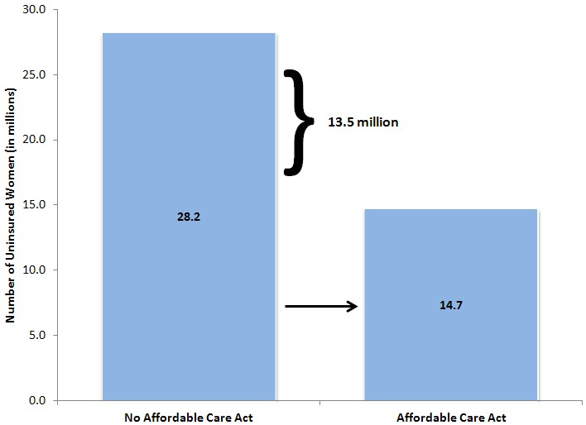
Women, Parity and the ACA
Source: RAND COMPARE micro simulation model. Estimates shown are for 2016 ages 0-64.
Notes:
Trainer: At a minimum, federal guidelines requires inmates to receive the following services (Hills, Siegfried, and Ickowitz, 2004):
A mental health screening upon entry to an facility and follow up assessment within 14
A mental health examination, including evaluating risk of suicide
Information within 24 hours of arrival about the types of mental health services available and how to access them
A health appraisal within 7 days of arrival that includes taking a history of any prior mental health problems, hospitalizations, psychotropic medications, suicide attempts, and alcohol and other drug abuse
Stabilization of any symptoms and an intervention in the event of an acute psychiatric event or suicide attempt
Privacy and confidentiality with regard to diagnosis and treatment.

Slide 11
Next Steps
Determine your State’s process for insurance enrollment
Specific policies and practices to enroll justice-involved individuals?
Specific state law and/or policy on Medicaid suspension or termination for incarcerated people?
Process for certifying agencies for enrollment activities state-based
Understand the landscape of decision-makers and how to determine coverage options
Did your state expand Medicaid? Which services, including MH and SUD services, will be covered? Is your state a Health Home state? Who is running your state’s Marketplace? Which Marketplace plans provide the strongest coverage options for people with complex health needs?
Notes:
Trainer: Inmates with co-occurring disorders face the “triple whammy” of having a mental illness, being addicted to drugs or alcohol, and being in prison. The most important point here is that both disorders change the brain and the way that people think, act, and reason. There are ways that both correctional officers and clinicians can interact with people with co-occurring disorders that help to minimize symptoms and promote a safe and secure correctional environment.

Slide 12
Examples
Transitions clinic
Philadelphia – faith based enrollment support
Spokane Community Court
The power of one: be the innovator in your jurisdiction. We are here to help!
Notes:
Trainer: Inmates with co-occurring disorders face the “triple whammy” of having a mental illness, being addicted to drugs or alcohol, and being in prison. The most important point here is that both disorders change the brain and the way that people think, act, and reason. There are ways that both correctional officers and clinicians can interact with people with co-occurring disorders that help to minimize symptoms and promote a safe and secure correctional environment.

