Slide 1


3rd RSAT TTA Conference
The Neurobiology of Addiction & Effective Treatment
Redonna K. Chandler, Ph.D.
Acting Director, Division of Epidemiology, Services and Prevention Research
National Institute on Drug Abuse, NIH
July 18, 2014

Slide 2
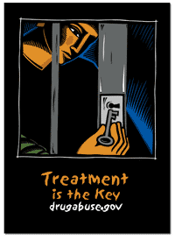
The National Institute on Drug Abuse
World’s largest funding source for substance abuse research

Slide 3
Outline
Substance Use in the Criminal Justice System
CJ involvement provides an opportunity to provide treatment
Treatment works; it improve lives, reduces recidivism, saves money, and builds strong communities

Slide 4
Substance Use in the
Criminal Justice System

Slide 5
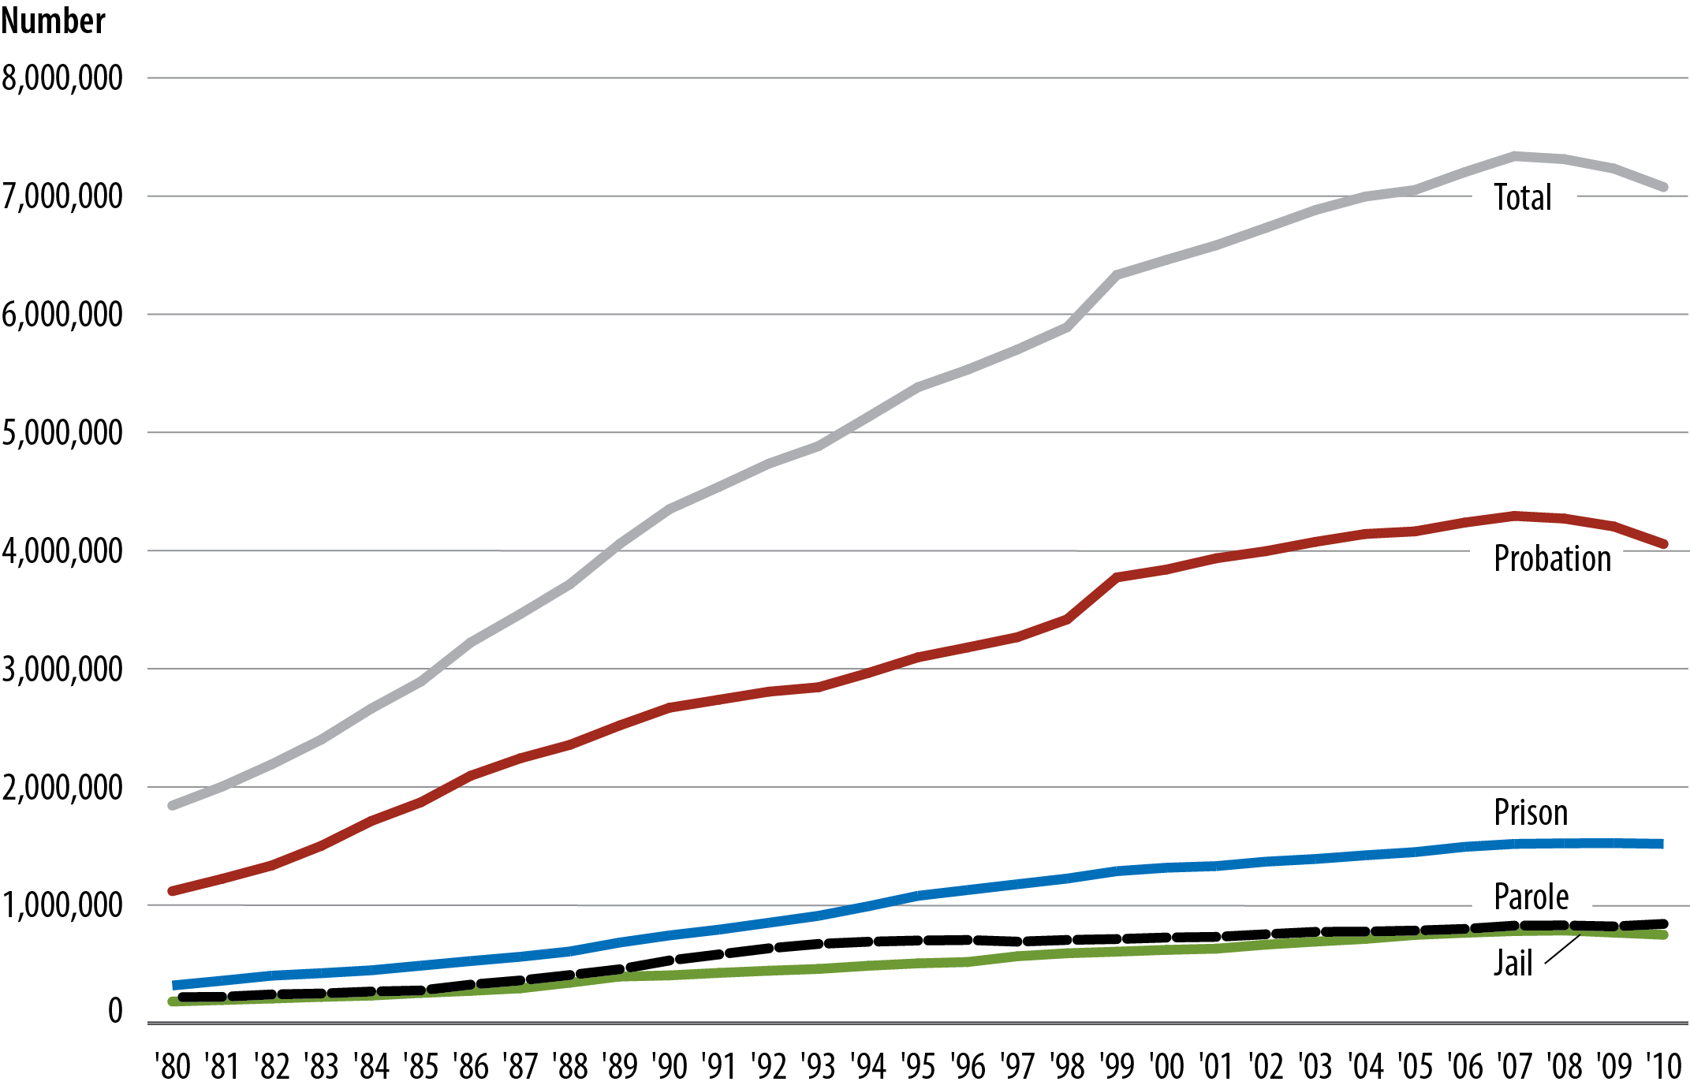
U.S. Adult Correctional Population:
Since 2005, combined federal, state, local adult correctional population has been over 7 million.
Source: Bureau of Justice Statistics, 2011

Slide 6
Drugs & Crime
Adults
Juveniles
Illicit Drugs
69% regularly use
56% use in month preceding offense
32% using @ time of offense
53% meet criteria for SUD
70% prior drug use
50% test positive for drugs
23% meet criteria for SUD
Alcohol
66% regularly use
33% using @ time of offense
40% regularly use
80% with violent offenses
Sources: BJS, 2004; Belenko & Logan, 2003; Mulvey et al, 2010
Notes:
Among the incarcerated for adults. *These are state prisoner #’s. Federal prisoner #’s are pretty similar: 78% ever, 64% regular, 50% month before, 26% at the time
Also note that according to 2010 data, 18% of state and 51% of federal inmates were serving time for drug offenses.

Slide 7
Justice Populations aren’t getting treatment
Need Treatment
GET Treatment
5,613,739 adults
253,034 juveniles
7.6% adults
21.5% juveniles
BJS, 2005 adjusted with estimates from Taxman, et al, 2007.
Notes:
5,613,739
adults need TX
(4.5M males,
1.1M females)
424,046 adults
receive tx (7.6%)
253,034 juveniles need TX (198,000 males, 54,000 females)
54,496 juveniles
GET tx (21.5%)

Slide 8
While incarcerated, few receive treatment
Mumola & Karberg. Drug use and dependence, state and federal prisoners, 2004. BJS, 2006 (rev 07)
Notes:
1) Dependent & abuse: 40% state, 28% fed; dep only: 1% state, 1% fed; abuse only: 17% state, 17% fed; dep &/or abuse: 53% state,46% fed (Table 5)
2) “Treatment is defined as substance care received under the supervision of a trained professional, including treatment in a special residential facility, professional counseling, detoxification unit, or use of a maintenance drug.” (p. 8, Table 9)

Slide 9
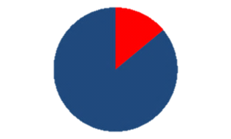
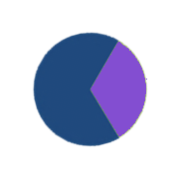
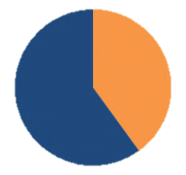
Infectious Diseases in the Correctional System
Each year:
      14% of all people in the US with HIV
      33% of those with HCV
      40% of those with Tuberculosis
pass through correctional facilities.
Source: Spaulding et al. (2009); Hammett, Harmon, & Rhodes (2002). AJPH, 92 (11), 1789-1794.
Notes:
In a given year, 14% of all people in the United States with HIV will pass through a correctional facility—as will 33% of those living with Hepatitis C and 40% of those with tuberculosis.

Slide 10
Prevalence of Health Screening
& Services in Adult CJ
% Facilities Providing Service
Source: CJ-DATS National Criminal Justice Treatment Practices Survey, NIDA
Notes:
QUESTION: Can you send me the report for this so I can read & understand it better?
To what extent do correctional facilities screen for and treat these chronic conditions? According to data collected as part of NIDA’s Criminal Justice Drug Abuse Treatment Studies, in a survey of X facilities, 60% of prisons reported (routinely? Ever?) screening for HIV/AIDS, though fewer reported providing HIV treatment or counseling. Rates were far lower in jails and community correctional settings. And it’s important that these are percentages of facilities that reported they provided the service—it doesn’t represent the percentage of prisoners receiving these screenings. Overall, these rates, with the exception of TB are very low.
Asked if provide screening and actual rates of individuals receiving screening is much less. Exception is for TB which is quite good.

Slide 11
Criminal Justice Involvement is an Opportunity to Intervene

Slide 12
Addressing Drug Abuse in the Criminal Justice System
ARREST/
PRETRIAL
PROSECUTION
(Court, Pre-Trial Release, Jail)
ADJUDICATION
(Trial)
SENTENCING
(Fines, Community
Supervision,
Incarceration)
CORRECTIONS
(Probation, Jail, Prison)
COMMUNITY
REENTRY
(Probation, Parole, Release)
Intervention Opportunities
Screening/
Referral/
Brief intervention
Diversion
Drug Courts
Community Treatment
TASC
N/A
Drug Court
Terms of
Incarceration
Probation Conditions
Deferred sentence
Drug
Treatment
Drug treatment
Aftercare
Housing
Employment
Mental Health
Half-way House
TASC

Slide 13
Benefits of integrated system:
The potential to save lives
Death Among Recent Inmates of the Washington State Corrections Compared to Other State Residents
Binswanger et al. NEJM
2007;356:157-165
Notes:
Figure 1. Mortality Rates among Former Inmates of the Washington State Department of Corrections during the Study Follow-up (Overall) and According to 2-Week Periods after Release from Prison. The dashed line represents the adjusted mortality rate for residents of the State of Washington (223 deaths per 100,000 person-years), and the solid line represents the crude mortality rate among inmates of the state prison system during incarceration (201 deaths per 100,000 inmate person-years).

Slide 14
Benefits of integrated system: The potential to reduce recidivism

Slide 15
Treating Addiction in the
Criminal Justice System is Cost-Effective
Cost of
Treatment
$4,700
Cost of Incarceration
$24,000
Cost of 1 full year of methadone
Cost of 1 full year of imprisonment
Cost to society of drug use = $193 billion/year (Carnevale/DOJ, 2011)
2/3 of this cost due to drug-related crime (Belenko et al., 2005; ONDCP, 2001)
Every $1 invested in treatment yields up to $7 in reduced crime-related costs (Ettner et al., 2006)
Drug courts and Prison treatment + aftercare is cost effective (McCollister et al., 2003, 2004)

Slide 16
Substance Abuse Treatment Works

Slide 17
What is Addiction?
A developmental brain disease expressed as a compulsive behavior.
The continued use of a drug despite negative consequences.

Slide 18
Addiction is a developmental disease
beginning in childhood and adolescense
Age at tobacco, at alcohol and at cannabis dependence per DSM IV
1.8%
Marijuana
1.6%
Alcohol
1.4%
Tobacco
1.2%
dependence
% in each age group who develop
1.0%
0.8%
0.6%
first
0.4%
0.2%
0.0%
Age
5
10
15
21
25
30
35
40
45
50
55
60
65
Age
NIAAA National Epidemiologic Survey on Alcohol and Related Conditions, 2003.

Slide 19
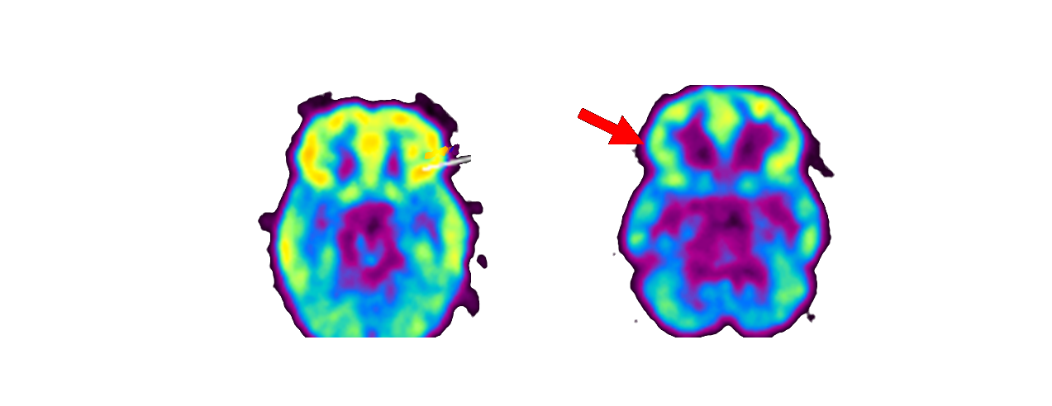
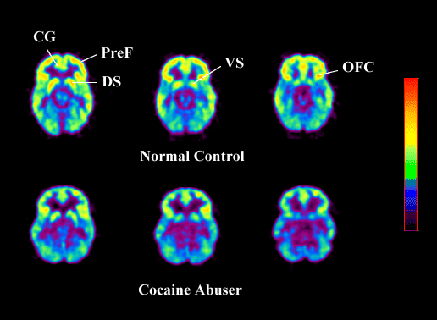
Addiction Is A Disease Of The Brain:
Decreased Brain Metabolism in Drug Abuse Patient
Brain Activity
High
No Cocaine Abuse
Cocaine Abuser
Low

Slide 20
Key Question:
Why Can’t Addicts Just Quit?

Slide 21
It’s About Dopamine (mostly)
Dopamine is the brain’s primary “pleasure chemical”
Dopamine plays a role in attention, problem solving, and the anticipation of reward
Dopamine is implicated in the drug high, as well as in the craving that accompanies withdrawal.

Slide 22
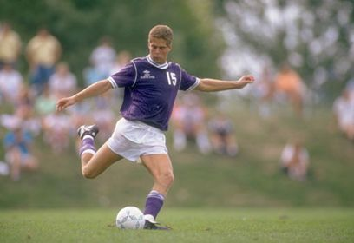
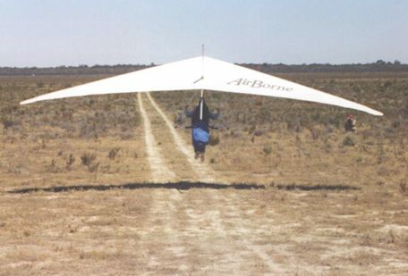
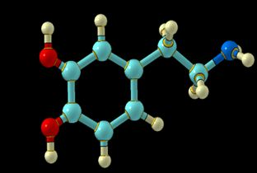

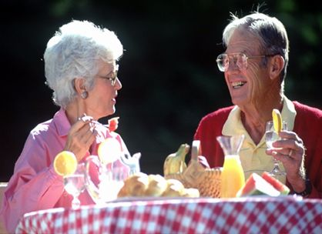
Dopamine
Movement
Motivation
Addiction
Reward & well-being
Notes:
Dopamine is a brain chemical involved in many different functions including movement, motivation, reward — and addiction. Nearly all drugs of abuse directly or indirectly increase dopamine in the pleasure and motivation pathways and in so doing, alter the normal communication between neurons.

Slide 23
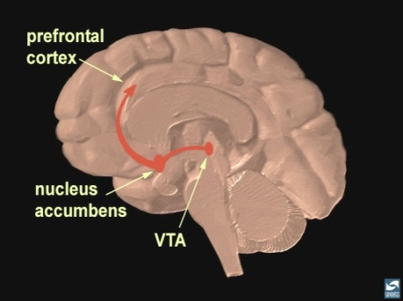

Natural Rewards Elevate
Dopamine Levels
Food
Sex
200
200
NAc shell
150
150
% of Basal DA Output
DA Concentration (% Baseline)
100
100
Empty
50
Box Feeding
Female Present
0
0
60
120
180
Sample
Number
1
2
3
4
5
6
7
8
Time (min)
Di Chiara et al., Neuroscience, 1999.,Fiorino and Phillips, J. Neuroscience, 1997.

Slide 24
Drugs of Abuse Cause a Release of Dopamine
AMPHETAMINE
COCAINE
1100
Accumbens
Accumbens
1000
400
900
800
DA
300
DA
700
DOPAC
DOPAC
% of Basal Release
HVA
HVA
600
% of Basal Release
500
200
400
300
200
100
100
0
0
0
1
2
3
4
5 hr
0
1
2
3
4
5 hr
Time After Amphetamine
Time After Cocaine
250
NICOTINE
MORPHINE
250
Accumbens
Dose (mg/kg)
200
Accumbens
200
0.5
Caudate
1.0
% of Basal Release
2.5
150
% of Basal Release
10
150
100
100
0
0
0
1
2
3 hr
0
1
2
3
4
5hr
Time After Nicotine
Time After Morphine
Source: Di Chiara and Imperato

Slide 25

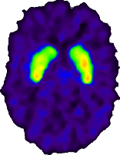
Repeated Drug Use Changes Brain:
Weakens Dopamine System
Control
Cocaine Abuser
T
Y
R
O
S
I
N
E
T
Y
R
O
S
I
N
E
T
Y
R
O
S
I
N
E
D
O
P
A
D
O
P
A
D
O
P
A
D
A
D
A
D
A
DA
D
A
DA
DA
D
A
D
A
D
A
D
A
D
A
COCAINE
D
A
D
A
D
A
D
A
D
A
D
A
D
A
D
A
D
A
D
A
D
A
D
A
D
A
PLEASURE
Repeated use of drugs reduces dopamine D2 receptors
Notes:
Exposure to drugs change the brain

Slide 26
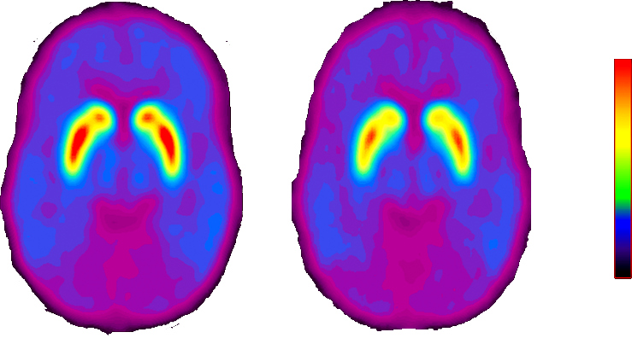

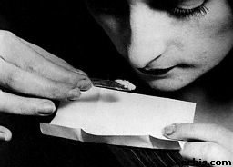
Dopamine Release Increases when Viewing Cocaine Cues
[¹¹C]Raclopride Binding In Cocaine Abusers (n=18) Viewing a Neutral and a Cocaine-Cue Video
Control Video
Cocaine Cue Video
Viewing a video of cocaine scenes decreased specific binding of [11C]raclopride presumably from DA increases
Volkow et al J Neuroscience 2006
Notes:
PET, looking at release of dopamine among cocaine addicts (on average 18 sub) when presented with different stimuli. Specifically targeted at looking at conditioned learning and whether dopamine is released when brain is exposed to “things” associated with drug use but not actually drugs. Used radio ligand measure release of dopamine when addicts exposed to neutral versus drug associated images. When see nature scenes see very little release of dopamine but when you expose them to cocaine images, you see release of dopamine. In part of brain involved with reward system. Also, measured craving.

Slide 27
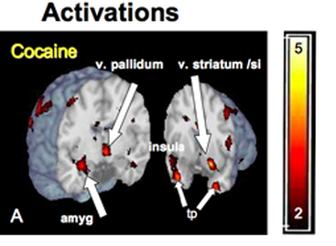
Even Unconscious Cues Can Elicit Brain Responses
Brain Regions Activated by 33 millisecond Cocaine Cues (too fast for conscious recognition)
Childress, et al., PLoS ONE 2008
Notes:
fMIR Brain responds to recognizable signals for sex and the rewarding effects of drugs but does this happen when they are “unseen” or unconscious – don’t even register in conscious brain? Showed rapid pictures of neutral, sexual, and drug cues to male cocaine addicts. Rapidly showed pictures of neutral, sexual, and drug scenes. Showed activation across the limbic and prefrontal cortex to these unconscious drug and sexual cues. Demonstrates brain’s exquisite sensitivity to signals for reward – those clearly needed for survival and drug rewards acquired “as if” signnificance because of actions on same brain circuitry. This response with drugs demonstrates Pavlovian conditioning where arbitrary cues that have signaled that cocaine is coming trigger physiological arousal, drug anticipation, activitation of limbic reward circuitry, and drive motivated behavior to seek out and use the drug.

Slide 28
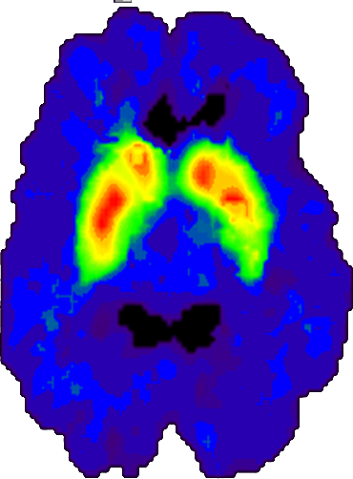
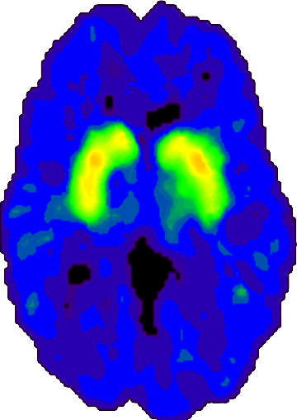
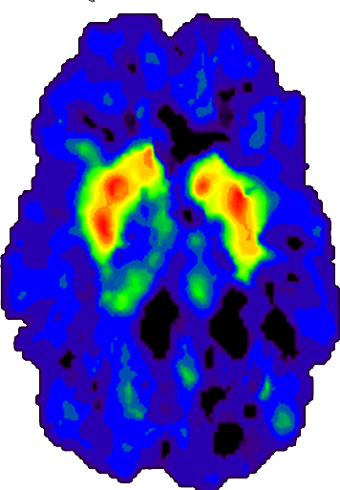
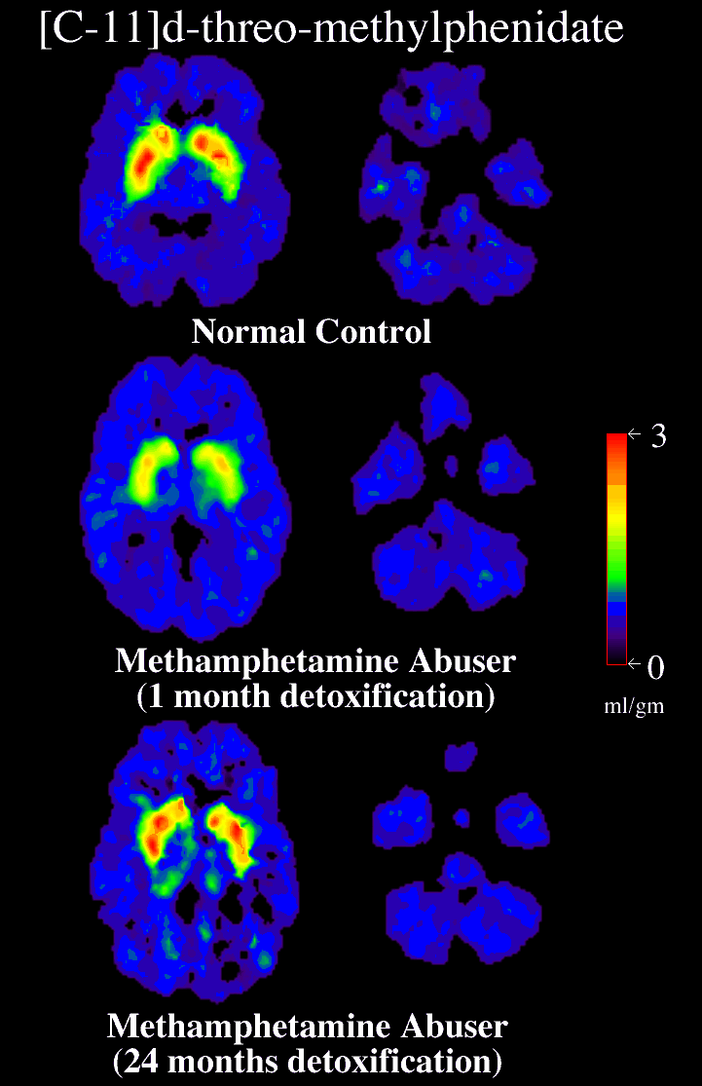
Recovery of Dopamine Transporters in
Following Abstinence
Normal Control
METH Abuser
(1 month detox)
METH Abuser
(14 months detox)
Source: Volkow, ND et al., Journal of Neuroscience 21, 9414-9418, 2001.

Slide 30
What is drug treatment?
A Chronic Care Approach
to Drug Treatment
“Prescription” for Services
Screening and Brief Intervention
Initial Services
Sustain
& Manage
Clinical
Practices
Assessment
Recovery/Chronic Care Management
Therapeutic
Interventions
Behavioral Counseling and Medications

Slide 31
What else does research suggest needs to be included in drug treatment?
Child Care
Services
Family
Services
Vocational Services
Intake Processing /
Assessment
Housing / Transportation Services
Mental Health Services
Behavioral Therapy and Counseling
Detoxification
Substance Use
Monitoring
Treatment Plan
Clinical and Case Management
Self-Help / Peer Support Groups
Financial Services
Pharmacotherapy
Medical
Services
Continuing Care
Legal Services
Educational Services
AIDS / HIV Services

Slide 32
Effective Treatment for Adult Offenders
Not Effective | Effective | Promising | Research Needed
Boot Camp | Residential TC’s | Moral Reasoning | Re-entry Courts
Intensive Supervision | CBT | Biofeedback/ Desensitization | Triage Models of Service Delivery
Generic Case Management | Contingency Management | Relaxation/ Counter Stress | New Medications
Lengthy Incarceration | Pharmacotherapy (medication) | Recovery Check-ups | Role of CJ Professionals
Harsh Punishment | Drug Courts | Computer delivered treatment | Peer Navigators
Self-help (as primary treatment) | Motivational Enhancement | Patient Navigators | Integrated Models of Care
Drug education | After-care/Transition Plans |  | Implementation of Effective Treatments
 | Relapse Prevention
 | Self-help (coupled with treatment)

Slide 33
Addressing Adolescent Substance Use in Juvenile Justice
Core Components | Prevention Interventions | Treatment Interventions | Research Needed
Change Behaviors & Cognitions | Strengthening Families Program | Brief Strategic Family Therapy | Juvenile Drug Courts
Involve Family | Big Brothers Big Sisters Community-Based Mentoring Program | Functional Family Therapy | Medication for Older Adolescents
Build Motivation | Positive Action | Multisystemic Therapy | Mentoring
Reward Change | Family Matters | Adolescent Community Reinforcement Approach (A-CRA) | Technology Facilitated Intervention
Set Goals | STARS for Families | Multidimensional Family Therapy (MFT)
Build Skills | Strong African American Families | Teen Intervene (TI)

Slide 34
What additional targets are important to address drug use and crime?
Target criminogenic need
Antisocial feelings, attitudes, orientations, values
Alcohol/drug problems
Anger/hostility
Problem solving
Conflict resolution skills
Attitudes toward school/work
Emotional problems
Family functioning
Barriers to care

Slide 35
Continuing Care is Important
Delaware Correctional System 3 Years Post-Release
Martin, Butzin, Saum, & Inciardi (1999)

Slide 36
Methadone Experiment: 6 Mo Post Release (N=201)
What is the role of medication?
Gordon, M.S., Kinlock, T.W., Schwartz, R.P., O’Grady, K.E. , 2008, Addiction
Notes:
Source: Gordon, M.S., Kinlock, T.W., Schwartz, R.P., O’Grady, K.E. (2008, in press). Addiction. A Randomized Clinical Trial of Methadone Maintenance for Prisoners: Findings at 6-Months Post-Release.
Stat sig: Tx days: A vs. B. vs. C sig; Crime days A vs C.
heroin days, opiod UA: A vs. C. Cocaine; UA ns (days: A vs B): cell ns=63, 68, 70; N=201.

Slide 37
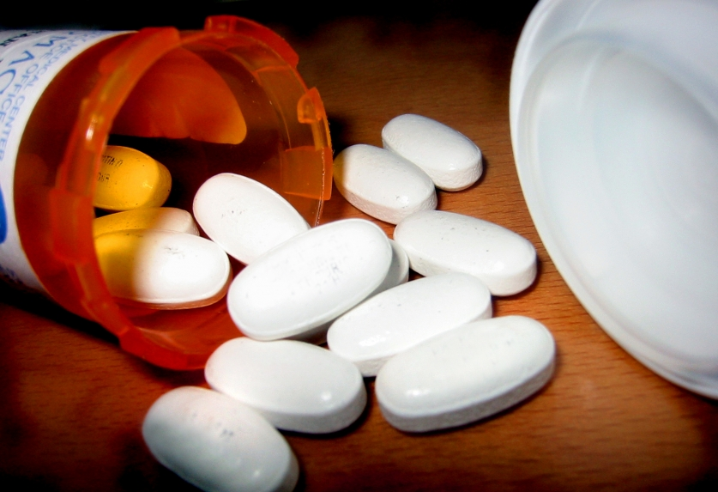
FDA Approved Medications for Alcohol & Nicotine
For alcohol dependence:
  Disulfiram
  Acamprosate
  Naltrexone (tablet, injectable)
For nicotine dependence:
  Varenicline, Buproprion
  Patch, gum, lozenge

Slide 38
FDA Approved Medications for
Opioid Addiction
Methadone
Buprenorphine (Subutex and generics)
Buprenorphine/Naloxone (Suboxone and generics)
Oral Naltrexone
Extended-release Naltrexone

Slide 39
What are relapse rates for drug addiction?
Relapse Rates are Similar to Other Chronic Medical Conditions
100
90
80
70
60
Percent of Patients Who Relapse
50 to 70%
50 to 70%
50
40
40 to 60%
30
30 to 50%
20
10
0
Drug
Dependence
Type I
Diabetes
Hypertension
Asthma
Notes:
Source: McLellan, A.T. et al., JAMA, Vol 284(13), October 4, 2000.

Slide 40
What does relapse mean?
Individual needs more treatment
Individual needs better treatment
Individual needs different treatment
Individual needs additional types of treatment
May not mean the person is crime risk

Slide 41
What does recovery look like?
Months 1-12 of Abstinence:
  More clean and sober friends
  Less use, homelessness, violence and victimization
  Less illegal activity and incarceration
Years 1-3 of Abstinence:
  Virtual elimination of illegal activity and illegal income
  Better housing and living situations
  Increasing employment and income
Years 4-7 of abstinence:
  More social and spiritual support
  Better Mental Health
  Housing and living situations continue to improve
  Dramatic rise in employment and income
  Dramatic drop in people living below the poverty line
Source: Dennis, Foss & Scott (2007)
Notes:
Source: Dennis, Foss & Scott (2007)

Slide 42
Things to Consider for Community Transition
Risk for relapse and overdose
Drug treatment availability in community
  What is evidence based treatment
Option of medication
Need for ancillary services
Client understanding regarding neurobiology of addiction
  Cues, stress, craving

Slide 43
Summary
Substance use disorders are prevalent in criminal justice system
Involvement = opportunity to intervene
Medications & behavioral therapies effectively address addiction in this population
Sustained treatment and preparing clients for community transition is important

Slide 44

www.drugabuse.gov
Redonna K. Chandler, Ph.D.
rchandle@nida.nih.gov

Slide 45
What has been the historic approach to addressing drugs & crime?
Public Health Approach
-disease
-treatment
Public Safety Approach
-illegal behavior
-punish
High Attrition
High Recidivism

Slide 46
New Approach:
Integrating Public Health and Public Safety
Opportunity to avoid incarceration or criminal record
Consequences certain and immediate
Community-based treatment
Collaborate to blend functions of criminal justice and treatment systems to optimize outcomes
Close supervision
Goal: Get people to treatment
Goal: Reduce recidivism

