Slide 1
Practical Implementation in the Community: Opportunities in the Affordable Care Act
Center for Health and Justice at TASC

Slide 2
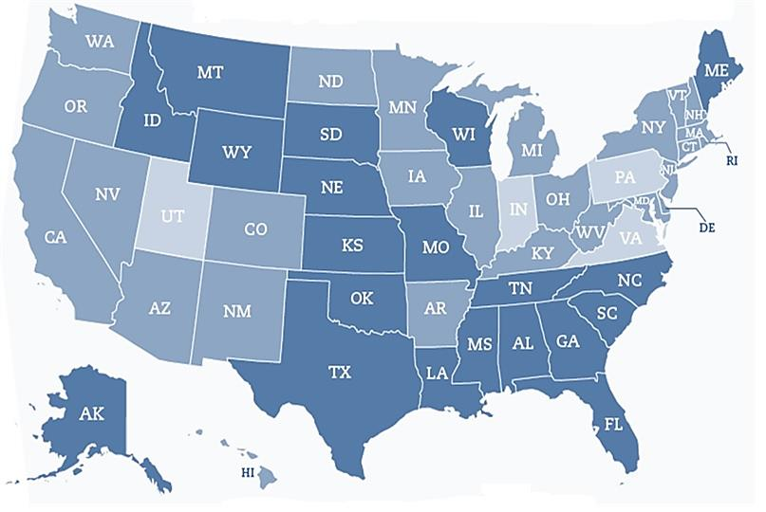
Medicaid Expansion
27 Expansion States: Arizona, Arkansas, California, Colorado, Connecticut, Delaware, District of Columbia, Hawaii, Illinois, Iowa, Kentucky, Maryland, Massachusetts, Michigan, Minnesota, Nevada, New Hampshire, New Jersey, New Mexico, New York, North Dakota, Ohio, Oregon, Rhode Island, Vermont, Washington, West Virginia
4 States to Watch: Indiana, Pennsylvania, Utah, Virginia

Slide 3
Statewide Snapshot: Illinois Parole
Illinois is a state-federal partnership marketplace. The state side of that partnership is called "GetCoveredIllinois"
In February 2014, GetCoveredIllinois joined forces with navigators and the Illinois Department of Corrections to set up enrollment at several parole sites statewide
More than 9,000 applications have been submitted

Slide 4
Work in Other States
Connecticut:
Began enrollment activity in 2009
Workers enrolling inmates at the Department of Corrections
Discharge planners present in every jail
50% of the people coming into the jail now are already enrolled
Within presumptive eligibility, only about .7% are found to be ineligible
California:
LA County Jail Pilot
Completed 150 applications at booking
Starting large-scale roll-out in July 2014
Behavioral Health provider in LA reached out to other counties, reached all 19 offices in 12 months
Forging systems relationships in order to ensure continuity of care

Slide 5
Focus on: County Work
Many counties are already planning and implementing programs to leverage health care for the justice system
Examples include:
Los Angeles, CA; Cook, IL; San Diego, CA; Maricopa, AZ; New York, New York; Philadelphia, PA; Salt Lake County, UT; Franklin, OH; Multonomah, OR and many more
New counties are getting started everyday

Slide 6
Cook County Planning
Spring 2011-the Illinois Criminal Justice Information Authority forms a working group with other state agencies to explore ACA opportunities for CJ populations
the working group becomes a part of Governor Quinn’s (D-IL) Healthcare Reform Implementation Council
August 2012-under the leadership of the Honorable Paul P. Biebel, Cook County justice systems begin ACA implementation process

Slide 7
Cook County Jail Enrollment
Cook County Jail-largest single-site jail in the country (200-300 adults admitted each day)
Fingerprint-based identifying information used to verify inmate identity
TASC staff complete applications online, using state and county Medicaid application websites and jail management system records
Each application takes approximately ten minutes
To date, over 15,000 Medicaid applications have been initiated
These applications experience a higher approval rate than applications made in the community.

Slide 8
Cook County Probation Enrollment
December 2012-clients from TASC, probation, and specialty courts enroll via a high-volume call center:
Applications have been initiated over the phone
Paper copies of necessary documentation are either mailed in or given to an in-person assister
Clients receive a mailed notice of approval or a notice alerting them that more documentation is necessary
TASC and the Cook County Adult Probation and Social Services Departments have engaged all direct care staff in the application process

Slide 9
Work in Other Counties
San Diego, CA
Fall of 2013-Began enrollment in probation and detention facilities
Certified enrollers are to enter and work in the facilities
Convening of advocacy groups and county officials to begin planning
In June/July 2014-Starting enrollment in the jail
Concentrating on the re-entry side
Multonomah, OR
Through databases, systematically targeted high-risk clients and enrolled a total of 3,000
Seven navigators complete forms and speak to them about health care literacy
Linking clients to care in the community
Use phone calls while incarcerated to make a clinic appointment in community
Discharge paperwork includes referrals and directions to clinics near them based on Google Maps zipcode look-up
Mental Health Community Providers have an office space in Jail to establish a pre-release relationship
Mental Health providers assist through ride-alongs with police officers and meet with individuals who are arrested

Slide 10
What Can RSAT Sites Do?
Partner with other organizations for leveraging Medicaid for jail and prison reentry
Contact:
Medicaid Authority in state
Existing Navigators
County Health Departments
Partners for accessing care in the community:
Managed Care Organizations
Affordable Care Entities
Health Homes systems

Slide 11
Future Planning
Focusing on care capacity and linkage to care in the community for the growing number of newly eligible persons in the justice population
Devoting efforts to building continuity of medical care between jails, prisons, and community
Most organizations agree that the ACA has unique and exciting implications for the justice population, and they are willing to engage in the changing landscape of healthcare
Working with Medicaid managed care plans on policies affecting the justice populations, in states that have managed care.

Slide 12
Contact Information
Pamela Rodriguez
President and Chief Executive Officer
312-573-8372
prodriguez@tasc.org

