Slide 1
RSAT Social Activities
Promoting Recovery With Social Learning Opportunities

Slide 2
Social Learning occurs by
participating, observing, and identifying with others.

Slide 3
All RSAT participants contribute to the social milieu.
Jail house culture or recovery-based culture?
Participants will benefit from activities which allow them to practice change.

Slide 4
Three Core Concepts to Social Learning Theory
People can learn through observation.
Mental states are important to learning.
Learning does not necessarily lead to a change in behavior.

Slide 5
Structured socialization is a step-by-step process through which RSAT participants learn prosocial behavior and attitudes and are given the opportunity to practice.
ACT AS IF…..

Slide 6
Physical Environment
Creating the sense of a special community can help disengagement from a previous lifestyle and promote a sense of effective citizenship.

Slide 7
Structured Activities
Community Meetings
Peer Leader Meetings
Peer Mentor Program
Morning Meetings

Slide 8
Community Meeting
Provides a ritual that helps define the RSAT culture
Enhances a sense of community
Provides a safe structure and predictability outside of scheduled didactic groups
Involves everyone
Assesses individual and collective moods
Resolves issues
Uplifting
Peer Lead

Slide 9
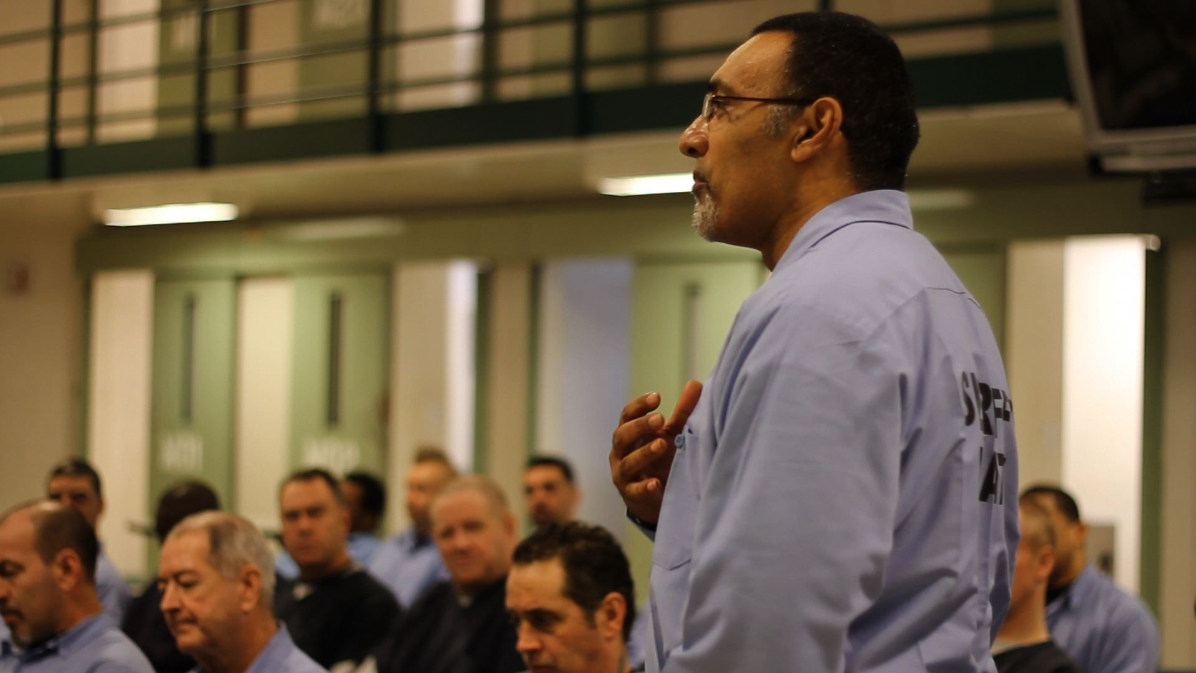

Slide 10
Community Meeting
General Spirits
Progressions
Regressions
Pull-Ups
Announcements/Graduations
Closing

Slide 11
Community becomes the instrument of Change

Slide 12
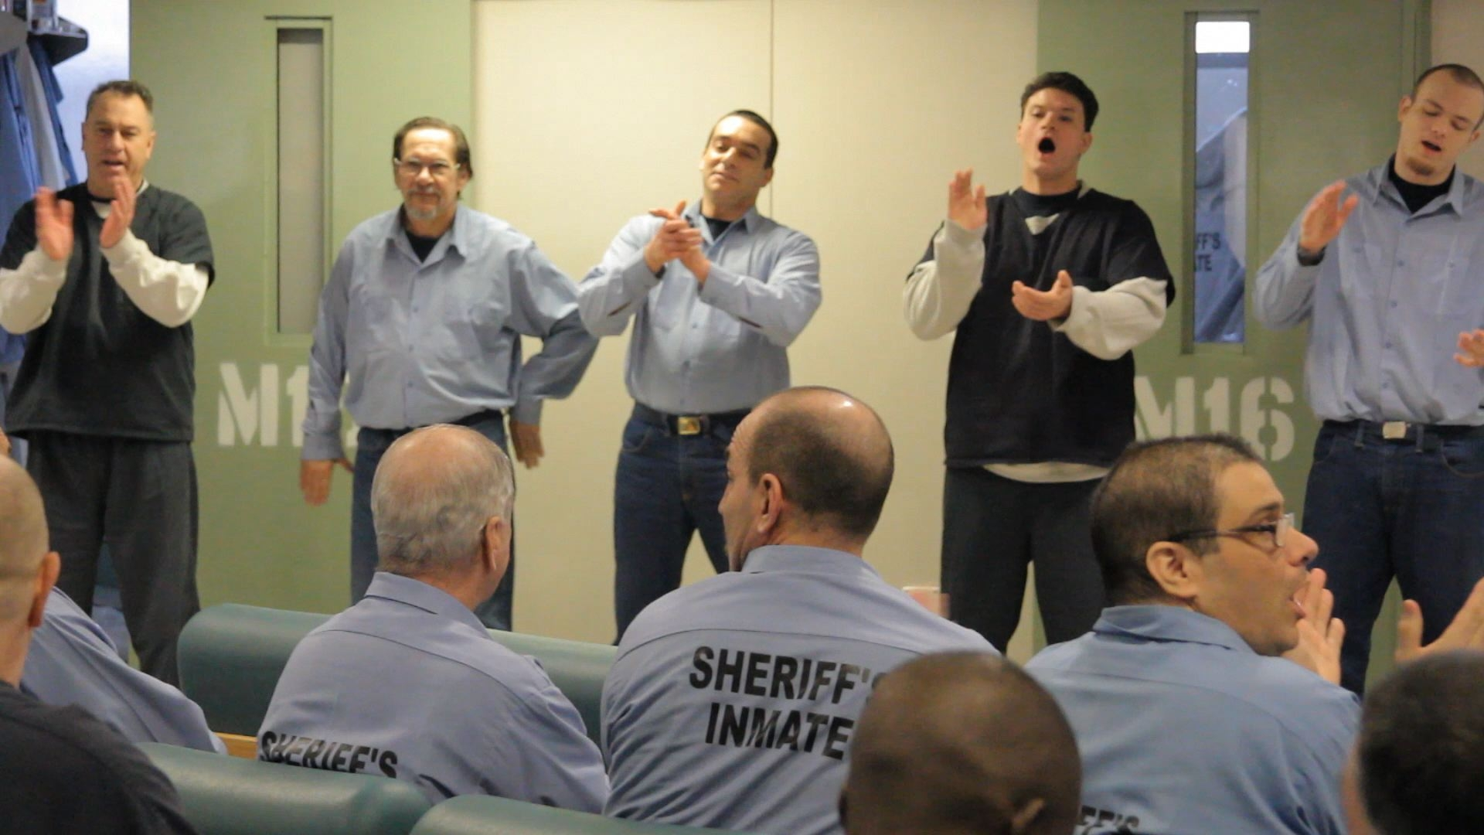

Slide 13
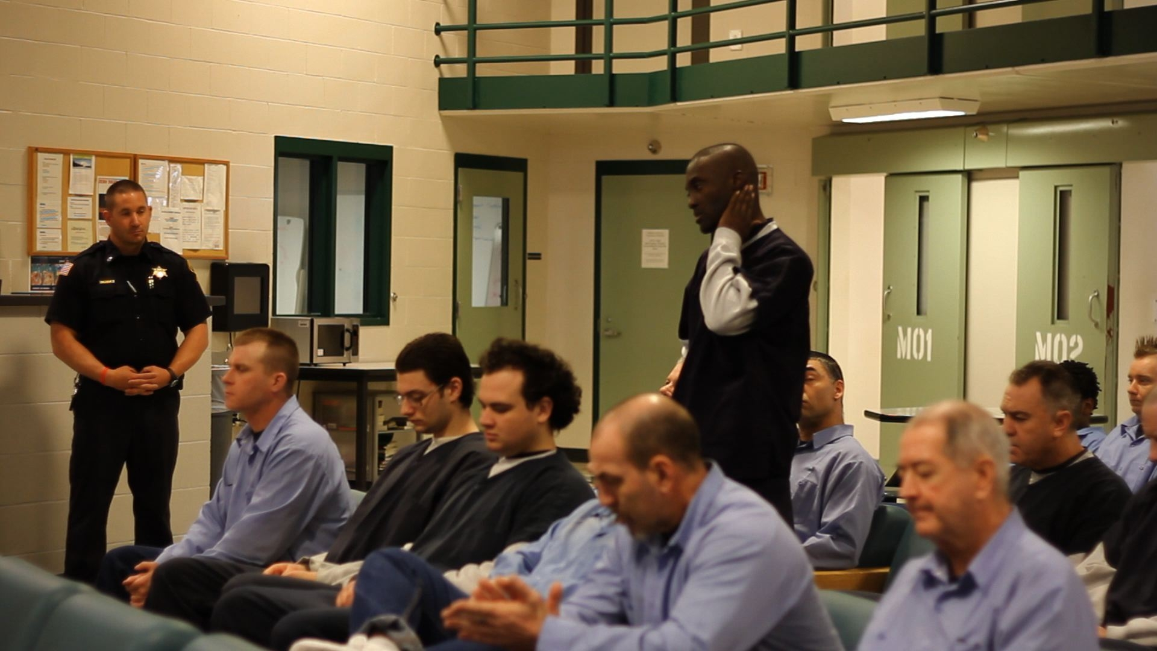

Slide 14
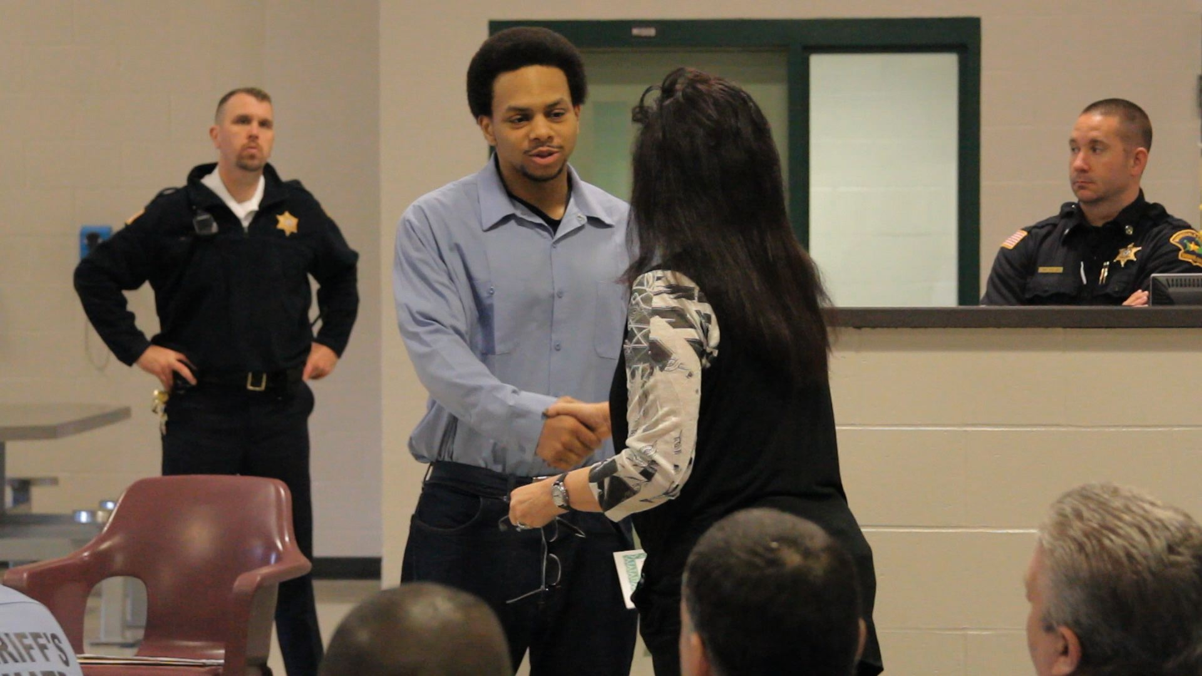

Slide 15
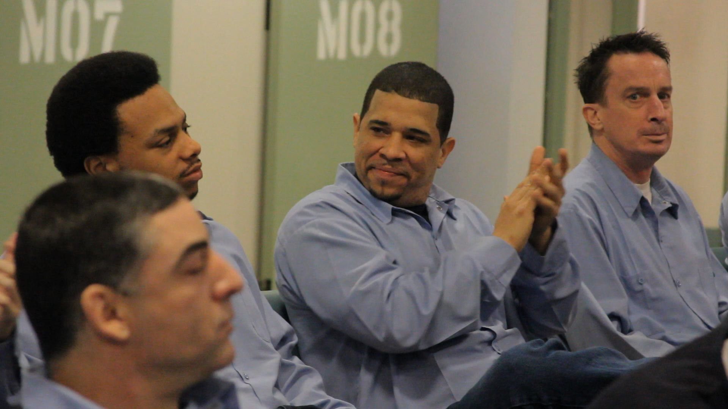

Slide 16
Peer Leader Meetings
Weekly
Structured discussion of issues brought to peer leaders
Attended by clinical staff and a security staff member with authority

Slide 17
Peer leaders are selected by officers and will:
Inform
Assist officers
Serve as chain of command between participants and staff
Prepare their group for activities
Do not have authority over other program participants

Slide 18
Morning Meeting
Brief daily meeting beginning with an inspirational reading followed by announcements
Flag Ceremony
RSAT participants will select theme of the day

Slide 19
Peer Mentor Program
Mentors are appointed by staff with input from existing mentors
Meet weekly with staff
Head peer mentor will organize assignments and discuss with other mentors throughout the week

Slide 20
Special Activities
Basketball Tournaments
Debates
Class presentations
Skits
Art Shows
Essay competitions
Poetry Readings

Slide 21
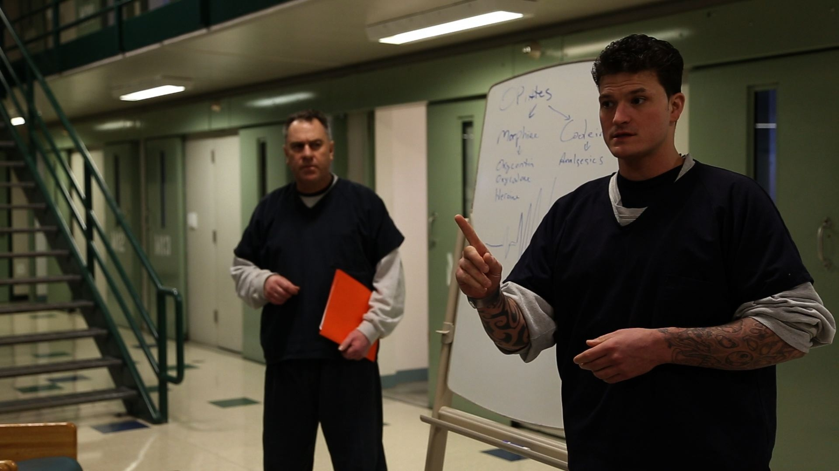

Slide 22
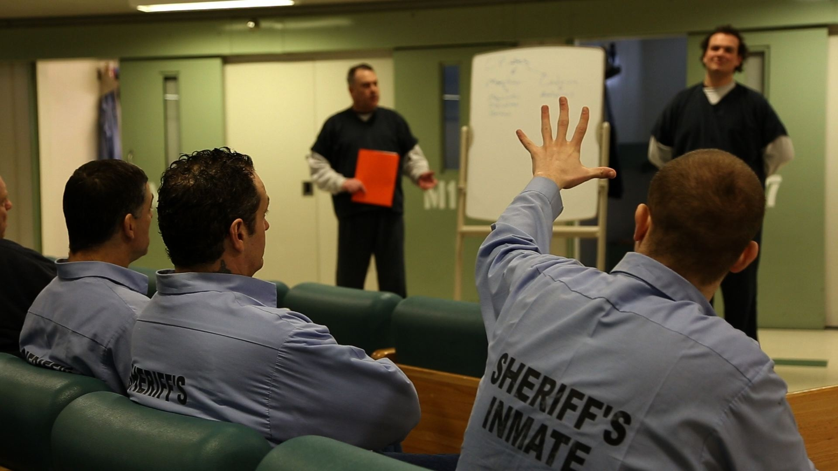

Slide 23
