Slide 1
MAT within correctional settings
Steve Seitchik, M.A.
Medication Assisted Treatment Statewide Coordinator
PA Department of Corrections

Slide 2
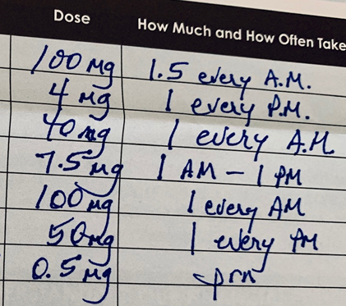
Medication has given me my life back!

Slide 4
5 years
10 years
3.5 years
10 years
6 years
20 years

Slide 5
What is Pennsylvania doing?

Slide 6
Overdose deaths in Pennsylvania went down by 18 percent from 2017 to 2018, dropping from 5,377 to 4,413.

Slide 7
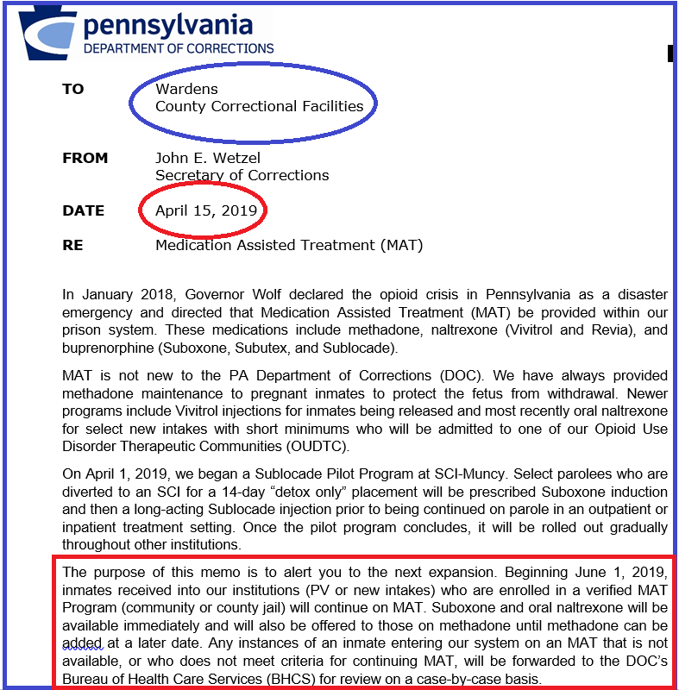

Slide 8
Medicaid
With many serious mental and physical health conditions, including SUD, reentrants require essential health care immediately upon release from incarceration.
To address this issue, PA DOC and PA Department of Human Services (DHS) have collaborated to create a process ensuring that Medical Assistance (MA) benefits will be in place for reentrants on the date of their release.
Included in the mission will be automated processing of Commonwealth of Pennsylvania Access to Social Services (COMPASS) applications for all of these reentrants.

Slide 9
Vivitrol (naltrexone for extended-release injectable suspension) is a prescription injectable medicine used to treat Alcohol and/or Opioid Use Disorder
Significantly reduces cravings
Up to 3 injections prior to release
Injection given every 28 days

Slide 10
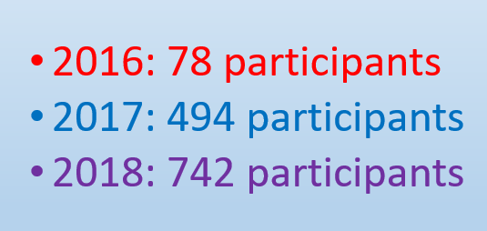
Implementing Vivitrol Inside SCIs
Signs of Success
Staff Initiative
Staff Buy-In
Teamwork
Sense of Urgency
Communication
COMPASS Application (Medicaid) done timely
2016: 78 participants
2017: 494 participants
2018: 742 participants
Weekly call-ins to the PA DOC’s Central Office are made in an effort to monitor the referrals.

Slide 11
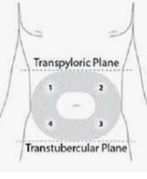
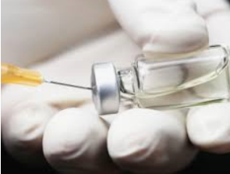
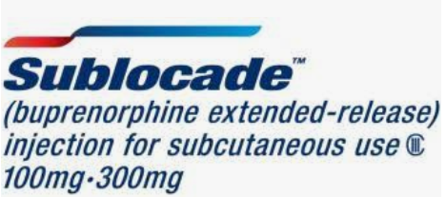

Slide 12
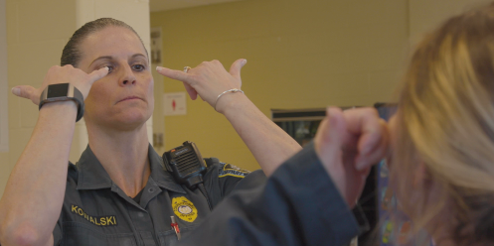
Injectable buprenorphine is ideal for jails/prisons
Reduces diversion of oral buprenorphine
Monthly medline vs. daily medline

Slide 13
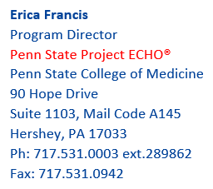
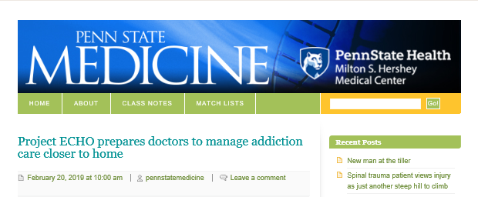

Slide 14
SCI Cambridge Springs, in conjunction with Greenfield Counseling Services (community-based OTP), provides Methadone to pregnant inmates with opioid addiction.

Slide 15
On March 12, 2018, the department converted six therapeutic communities (TCs) to opiate specific therapeutic communities.
Institutions with Opiate Specific TCs:
Albion (co-occurring, includes long term)
Cambridge Springs (females)
Camp Hill
Chester
Laurel Highlands
Quehanna Boot Camp (State Intermediate Program; 2-year flat sentence)

Slide 16
REFERRAL TO COMMUNITY-BASED PROVIDERS

Slide 17
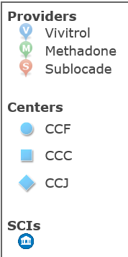
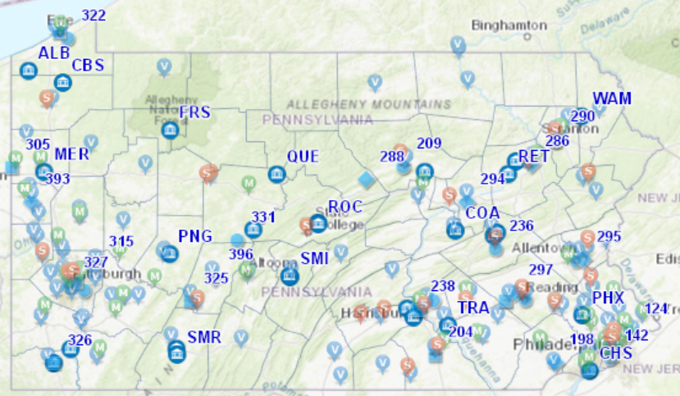
Methadone

Slide 18
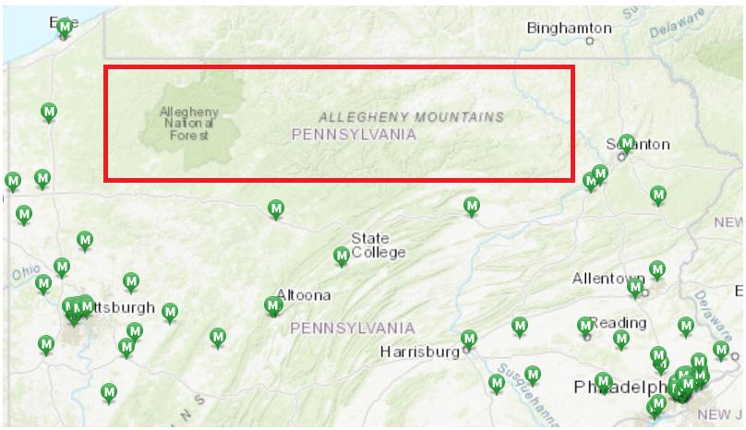
~ 200+ miles

Slide 19
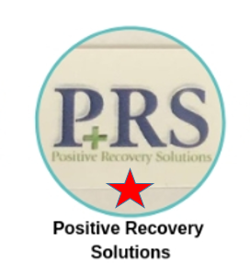
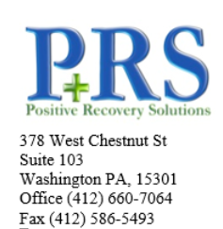
MOBILE VIVITROL

Slide 20
Barriers
Stigma against agonist medications (Security Staff, Physicians, Family Members, Community-Based Providers)
Stigma against medication in general
Lack of board certified addiction specialists
Decades of research supports common themes for avoiding treatment: cost, denial, navigating treatment system, insurance coverage, low reimbursement rates, competent providers and lack of awareness or knowledge.

Slide 21
Barriers
Despite pharmacologic treatments based on a generation of research, most treatment programs have minimal (if any) physician involvement.
Too often, treatment centers operate under outdated institutional ideologies modeled on mid-20th-century alcoholism treatment.
Misinformation (family, friends, physicians, nurses, certain Ted Talks, etc.)

Slide 22
Humans tend to discount evidence when it doesn’t fit our goals while embracing information that confirms our biases.

Slide 23
Playbooks

Slide 24
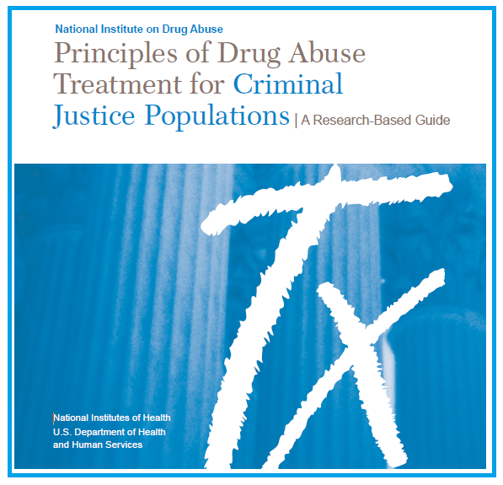
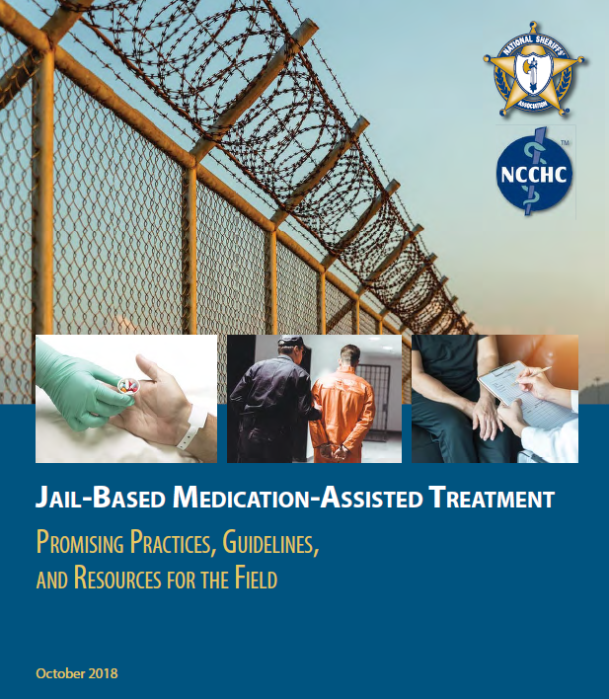

Slide 25
From AIDS to Opioids —
The response to the AIDS epidemic established a precedent for expanding access to lifesaving medications.
After the FDA approved zidovudine (‘87), the first HIV–AIDS medication, Congress approved $30 million in emergency funding to states to pay for HIV medications — laying the groundwork for what became the AIDS Drug Assistance Program, authorized by the Ryan White Comprehensive AIDS Resources Emergency Act in 1990.
Billions of dollars are currently being allocated for opioid addiction.
September 4, 2019: Pennsylvania will get about $70 million to continue fighting the opioid addiction crisis, federal officials announced Wednesday.

Slide 26
From AIDS to Opioids —
Intensive efforts have been devoted to training and supporting clinicians, many of whom are new to the treatment of addiction [similar to viral infections in the 90’s].
Regulations were loosened to allow the FDA to fast-track antiretroviral drug development for HIV beginning in the late 1980s.
The same is true for injectable buprenorphine (e.g., Sublocade).
However, access and affordability are issues.

Slide 27
The problems of the world cannot possibly be solved by skeptics or cynics whose horizons are limited by the obvious realities. We need individuals who can dream of things that never were…and ask why not.
JFK
6-28-63

Slide 28
Contact Information
Steven S. Seitchik
MAT Statewide Coordinator
Department of Corrections
Bureau of Treatment Services
1920 Technology Parkway
Mechanicsburg, PA 17050
Phone 717.448.4956
Email: sseitchik@pa.gov

